Slide 1
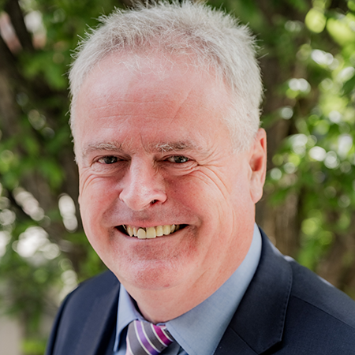
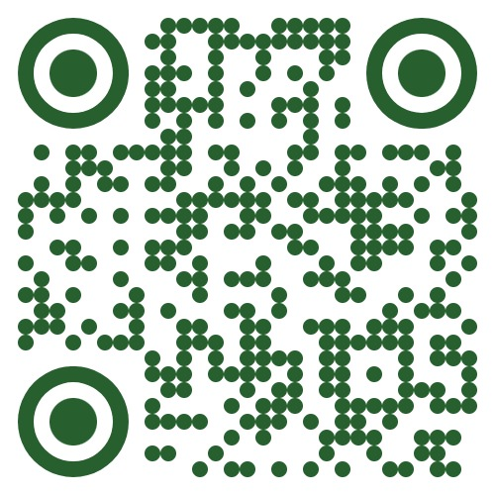
Making an impact in built environment research
Don Ward
Chief Executive, CIB
www.cibworld.org
Notes:
Hello, I’m Don Ward, CEO of CIB since 2020
Welcome to this short overview of CIB

Slide 2
Purpose
Follow-up actions are highlighted in yellow boxes
Slides available to review afterwards including extra content
An induction session for new CIB Board members
To meet fellow new Board members
To provide information on the role of the Board and the activities of CIB as governed by the Board
To help with preferences about committee/s and other duties to volunteer for
To answer questions about the role

Slide 3




The global network for
    Collaboration for
    Innovation in the
    Built environment
    International Council for
    Research and Innovation in
    Buildings and Construction
Notes:
CIB is the global network which stands for…

Slide 4


Our history
Established in 1953 as an NGO on the initiative of the United Nations
Conseil International du Bâtiment
pour la recherche, l'étude et la documentation
A global association with worldwide membership
“To support an improved building process and enhanced performance of the built environment”
Notes:
CIB is over 70 years old and was originally named in French…

Slide 5
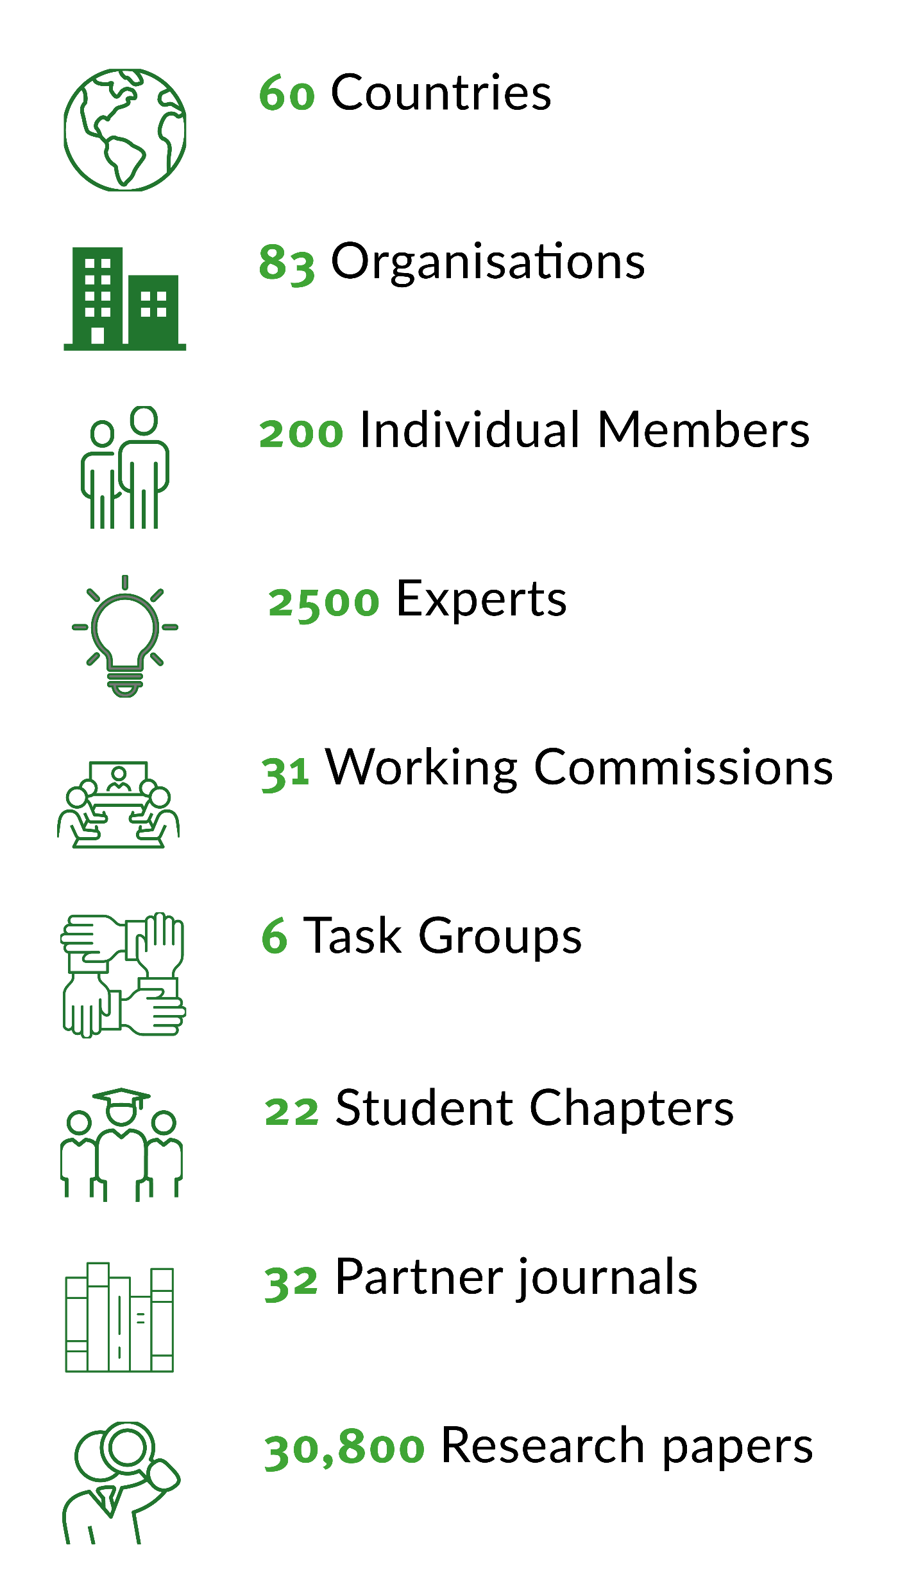
Adding value for global research
Global collaboration
  Over 40 interdisciplinary Working Commissions & Task Groups
    Conferences, webinars, publications, 32 partner journals, research roadmaps, research database, 30,000 papers
  World Building Congress very three years
    WBC2028, the 24th WBC will be hosted by
    Tsinghua University, Beijing, China,
    21st – 26th May 2028
Tomorrow’s talent
  26 Student Chapters
  Global network for Early Career Researchers
  CIB on YouTube: @CIBSecretariat
  Awards
Thought leadership, eg impact, research classification
Notes:
CIB adds value in 3 main ways….

Slide 6
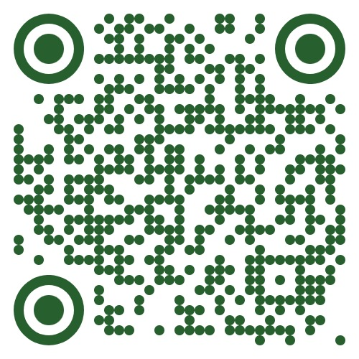
Current Working Commissions and Task Groups
AI in Construction
Architectural Design and Management
Building Pathology
Clients and Users in Construction
Construction in Developing Countries
Construction Industry Economics
Achieving Circularity in the Built Environment
Construction 5.0
Inclusive Built Environment
Culture in Construction
Disasters and the Built Environment
Education in the Built Environment
Facilities Management and Maintenance
Heat and Moisture Transfer in Buildings
Informal Settlements and Affordable Housing
Information and Knowledge Management in Building
Information Technology for Construction
Innovation in Construction
Intelligent and Responsive Buildings
Law and Dispute Resolution
Lean Construction
Nature Based Solutions
Near-Zero and Circular Built Environments
Offsite Construction
Open Building Implementation
Organisation and Management of Construction
People in Construction
Performance Measurement in Construction
Prediction of Service Life of Building Materials and Components
Procurement Systems
Public Private Partnerships
Residential Studies
Roofing Materials and Systems
Safety and Health in Construction
Sandwich Panels
Smart and Sustainable Built Environments
Social Value in Built Environment
Spatial Planning and Infrastructure Development
Urban-Rural Built and Natural Environment Synergies
Water Supply and Drainage
Notes:
The Working Commissions and Task Groups are the core of our work, and here is the list as of early 2025. New ones in 2024-2025 are higlighted,.
The topic coverage is not exhaustive, but the groups cover most of the crucial topics for improving our industry, and where current research is most active
You can dig deeper into the activities of each of these Commissions on the website.
Members may propose topics for new Task Groups at any time.
In recent times the agenda of sustainable development, social as well as environmental, has been increasingly reflected in the focus of new groups.
- Change which ones are highlighted depending on the audience

Slide 7
Current Working Commissions and Task Groups
Planning & Design
Architectural Design & Management
Inclusive Built Environment
Open Building Implementation
Residential Studies
Spatial Planning & Infrastructure Development
Informal Settlements & Affordable Housing
Digital
AI in construction
Information & Knowledge Management
Information Technology
Intelligent and Responsive Buildings
Performance Measurement
Operation
Building Pathology
Clients & Users
Facilities Management & Maintenance
Intelligent and Responsive Buildings
Prediction of Service Life
Social
Culture
Inclusive Built Environment
People
Safety and Health
Social value
Environmental
Circularity
Disasters
Nature Based Solutions
Near-Zero & Circular Built Environments
Smart & Sustainable Built Environments
Urban-Rural Built and Natural Environment
Water Supply and Drainage
Materials
Prediction of Service Life
Roofing Materials & Systems
Sandwich Panels
Management
Clients & Users
Construction 5.0
Economics
Law & Dispute Resolution
Lean
Organisation & Management
Procurement
Public Private Partnerships
Developing Countries
Developing Countries
Disasters
Informal Settlements & Affordable Housing
Offsite
Customised Industrial Construction
Offsite Construction
Other
Education
Innovation
Notes:
The Working Commissions and Task Groups are the core of our work, and here is the list as of early 2025
The topic coverage is not exhaustive, but the groups cover most of the crucial topics for improving our industry, and where current research is most active
You can dig deeper into the activities of each of these Commissions on the website.
Members may propose topics for new Task Groups at any time.
In recent times the agenda of sustainable development, social as well as environmental, has been increasingly reflected in the focus of new groups.
- Change which ones are highlighted depending on the audience

Slide 8
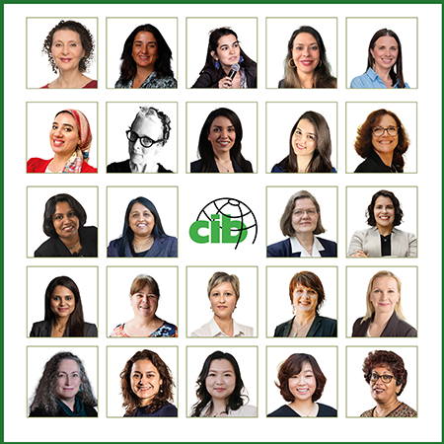
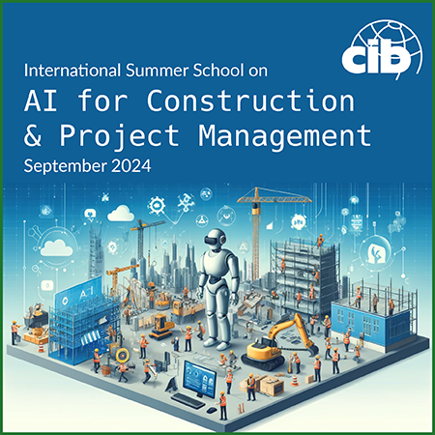
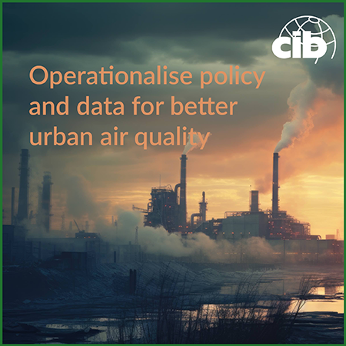
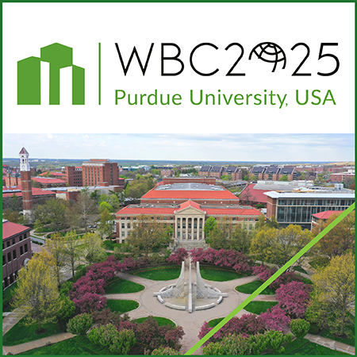

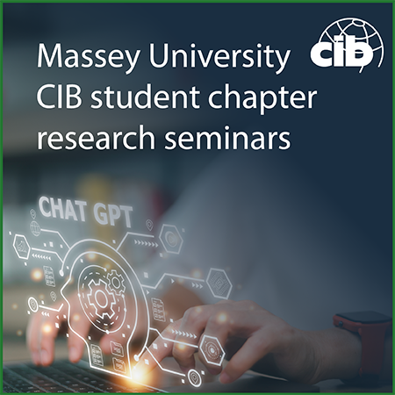
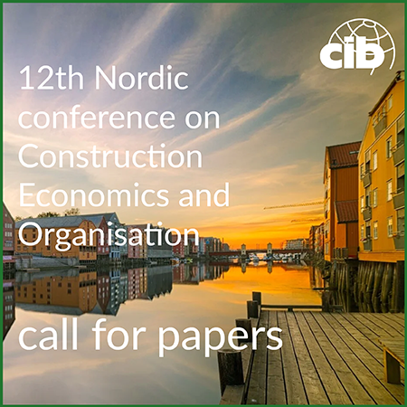
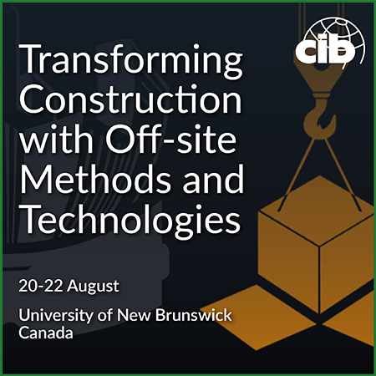




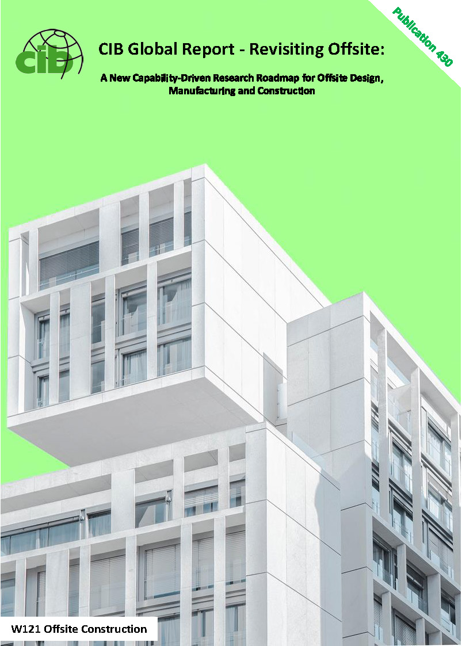
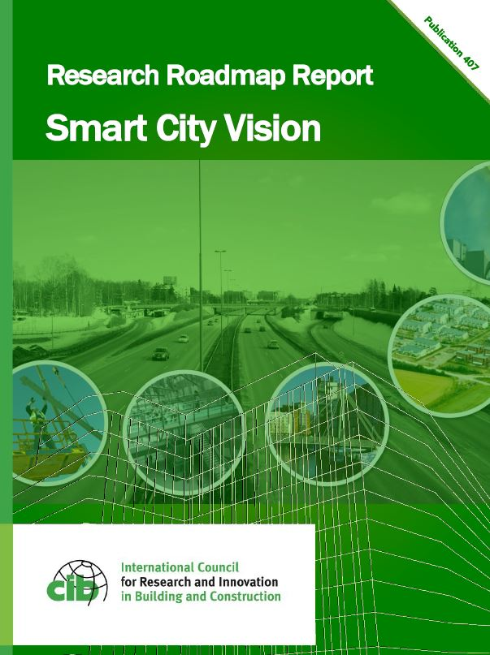
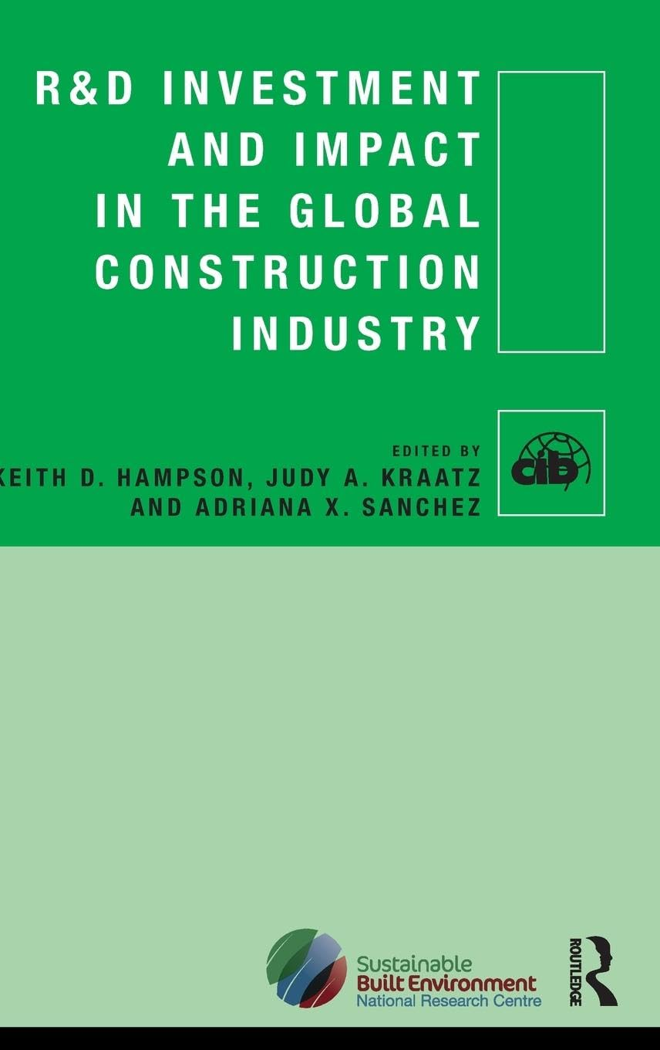

Commissions’ outputs
Conferences
Webinars and CIB on Youtube
Reports and books
Over 30 endorsed scientific journals
@CIBSecretariat

Slide 9
Conferences
CIB W062 Water Supply and Drainage Conference, Miami, USA, August 2025, 50th annual conference
CIB World Building Congress, West Lafayette, USA, May 2025
W116 Smart and Sustainable Built Environments Conference, SASBE 2024, Auckland, New Zealand, November 2024
CIB W099 & W123 Conference - Digital Transformation of Health and Safety in Construction, Porto, Portugal, June 2023, and Kumasi, Ghana, October 2024
CIB W070 Conference - Facility Management and Maintenance, Trondheim, Norway, May 2023
Notes:
CIB’s Commissions also host conferences for research members and others to come together to share their work, network and collaborate

Slide 10
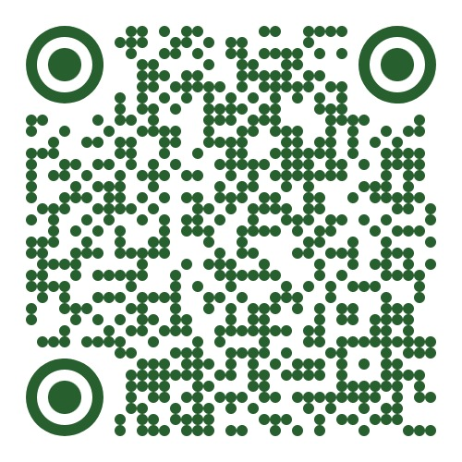

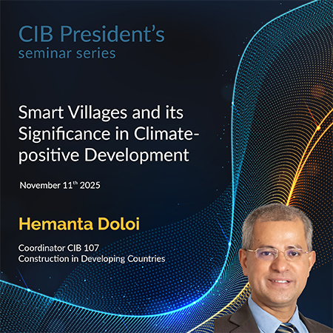
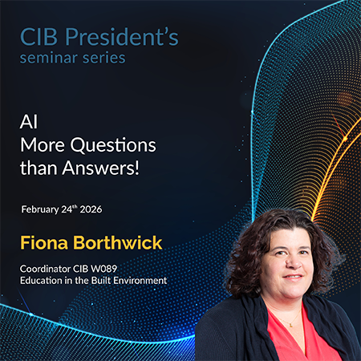
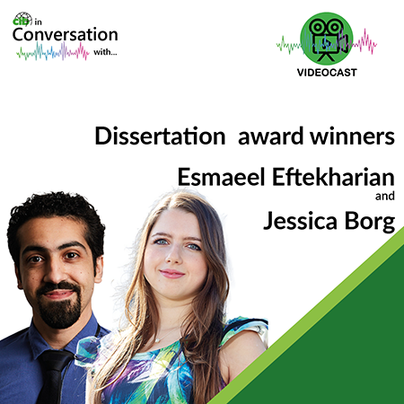
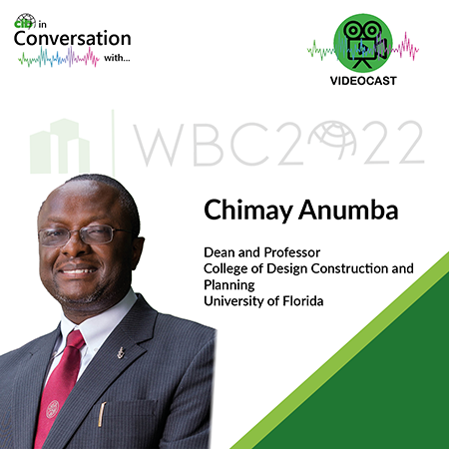
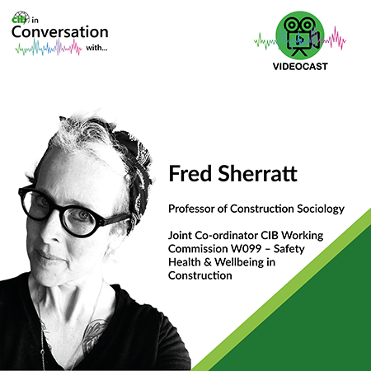
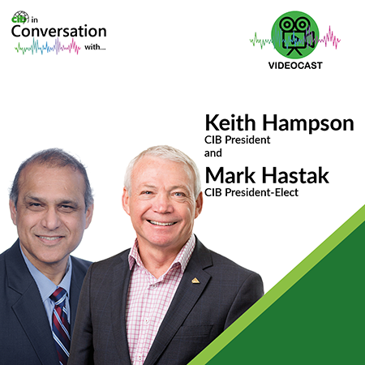
Webinars and CIB on YouTube
CIB President’s Seminar series, including distinguished women researchers
CIB in Conversation
Lots of webinars and other content
@CIBSecretariat
Notes:
A large number of webinars and lectures are hosted by CIB and its Commissions. The YouTube channel provides an excellent library of these.

Slide 11
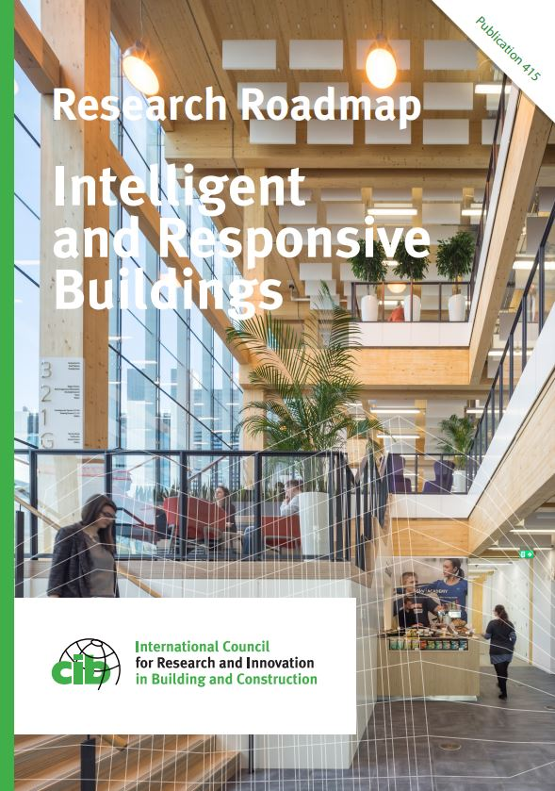
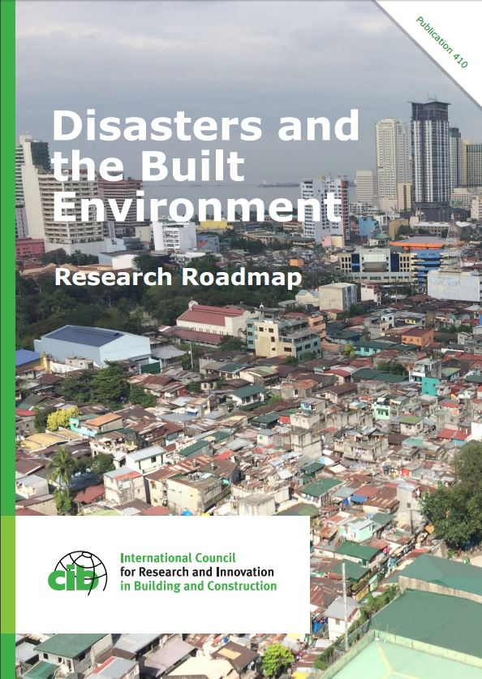
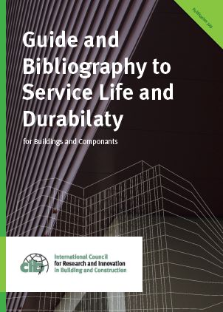

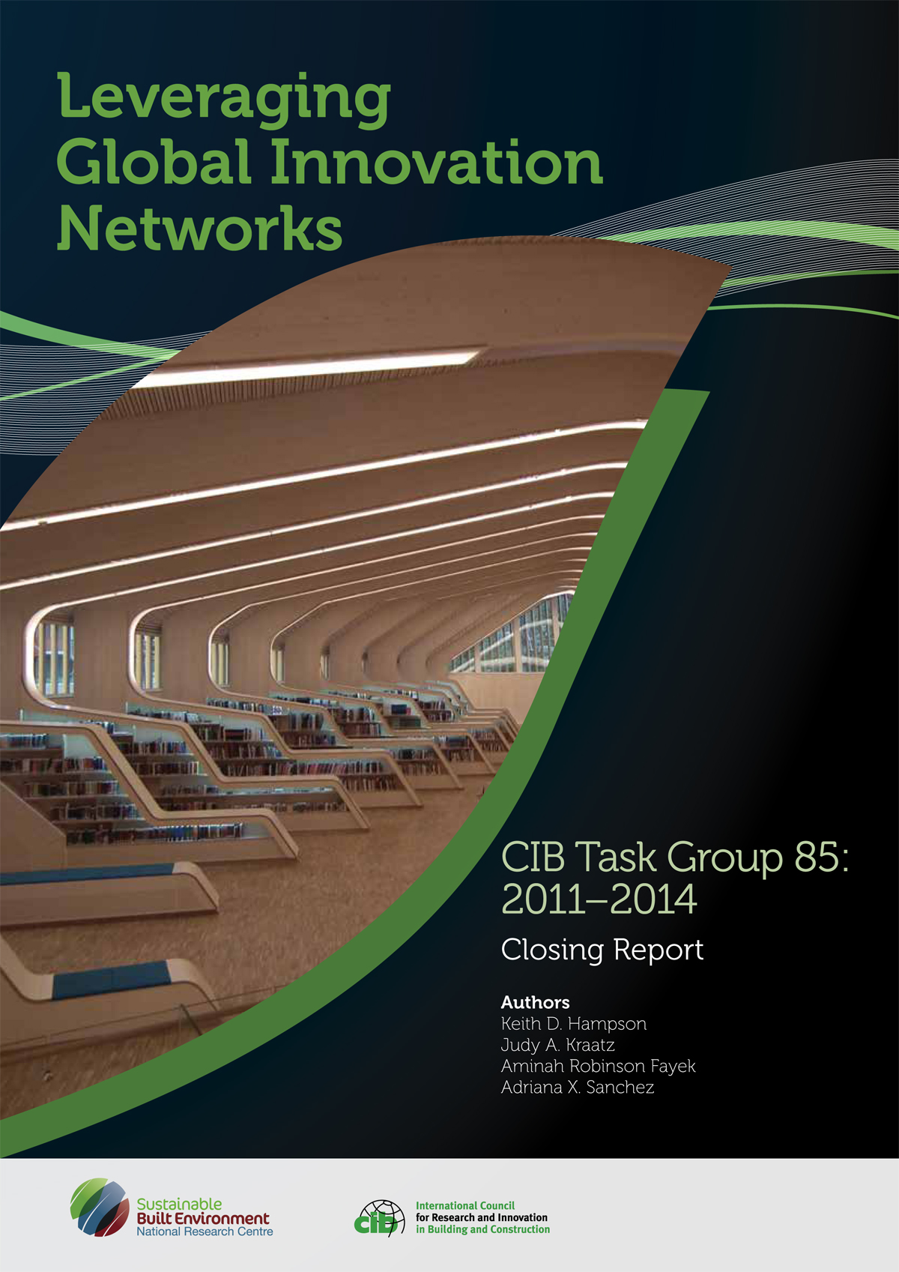
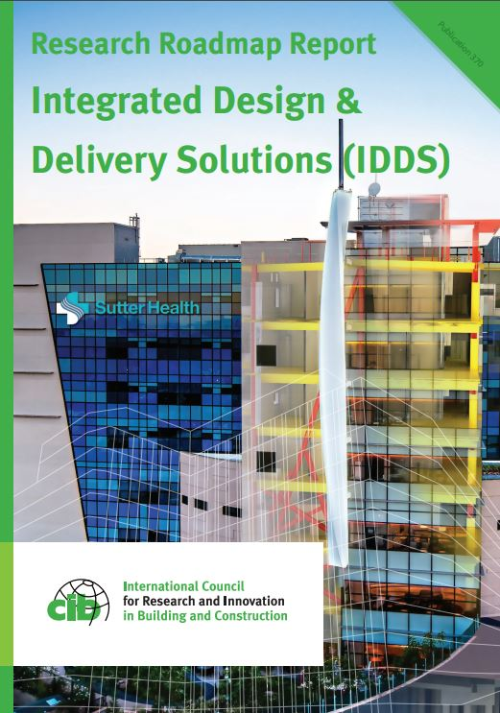
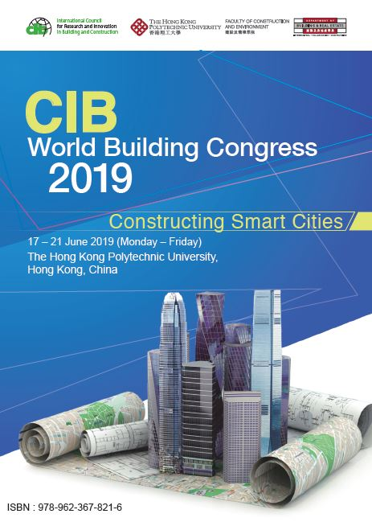



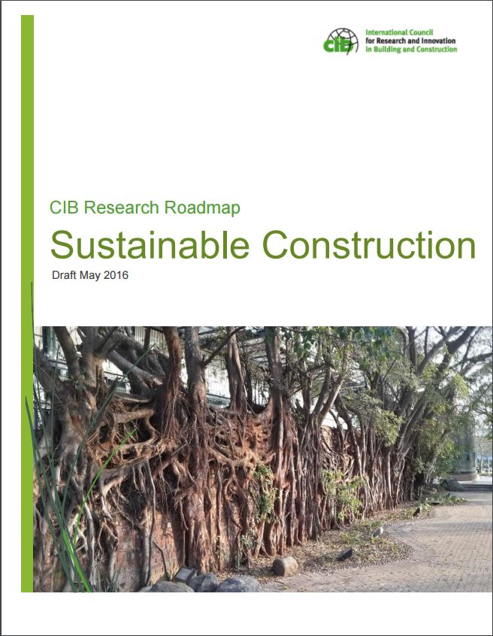
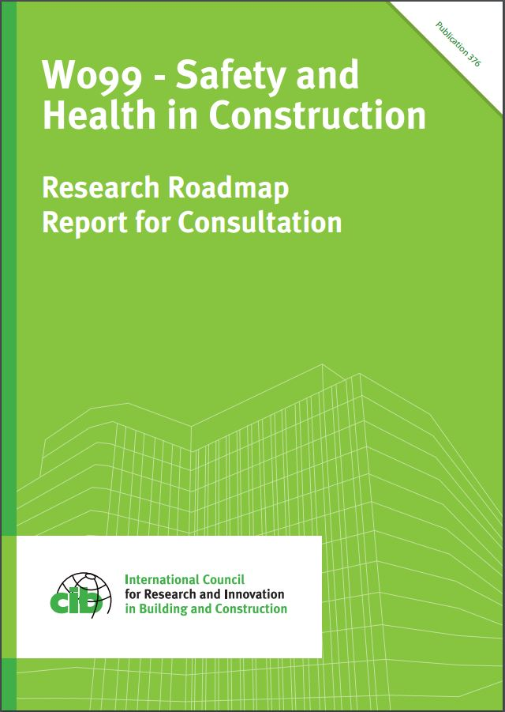

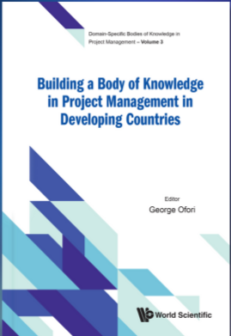
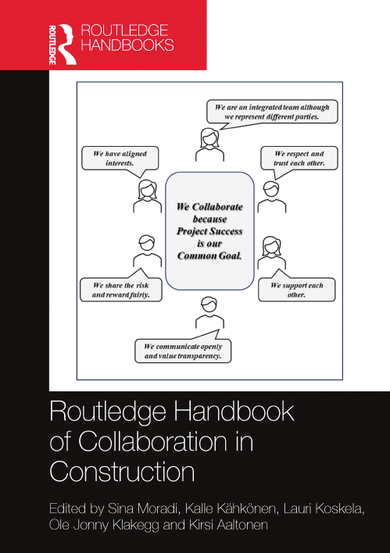
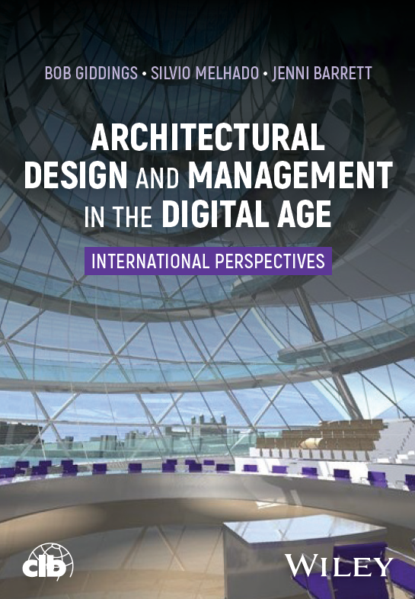
Reports and Books
Notes:
CIB’s Commissions and Task Groups provide a range of reports and publications, including research roadmaps setting out the future research agenda

Slide 12


Endorsed journals and publishing partnerships
Advancement of Performance Information & Value, Journal for - Kashiwagi Solution Model, Inc.
Architectural Engineering and Design Management - Taylor and Francis, Informa
Architecture Science, ArS - Architectural Institute of Taiwan
Building Pathology and Adaptation, International Journal of, IJBPA - Emerald
Building Physics, Journal of – SAGE
Building Research & Information, BR&I - Taylor and Francis, Informa
Buildings - MDPI
Buildings & Cities - Ubiquity Press
Built Environment Project and Asset Management, BEPAM - Emerald
Civil Engineering and Management, Journal of - Taylor & Francis, Informa
Construction Economics and Building, Journal of - UTS ePRESS
Construction in Developing Countries, Journal of - Penerbit Universiti Sains Malaysia
Construction Innovation: Information, Process, Management, CI - Emerald
Construction Management and Economics, CM&E - Taylor and Francis, Informa
Construction Management, International Journal of - Taylor and Francis, Informa
Disaster Resilience in the Built Environment, International Journal of, IJDRBE - Emerald
Engineering, Construction and Architectural Management, ECAM - Emerald
Engineering, Design and Technology, Journal of, JEDT - Emerald
Facilities - Emerald
Financial Management of Property and Construction, Journal of, JFMPC – Emerald
Frontiers in Built Environment – Frontiers
Informes de la Construcción - CSIC
Intelligent Buildings International - Taylor and Francis, Informa
ITcon – Journal of Information Technology in Construction
Management, Procurement and Law - ICE
Materiales de Construcción - CSIC
Open House International, OHI - Emerald
Property Planning and Environmental Law, Journal of, JPPEL - Emerald
Revista Ingeniería de Construcción, Journal of Construction Engineering - Department of Engineering and Construction Management of the Pontificia Universidad Católica de Chile
Smart and Sustainable Built Environment, SASBE - Emerald
Smart Cities - MDPI
Sustainability - MDPI

Slide 13
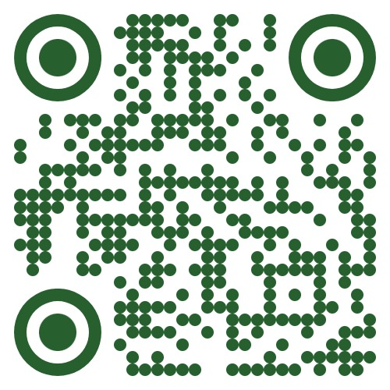
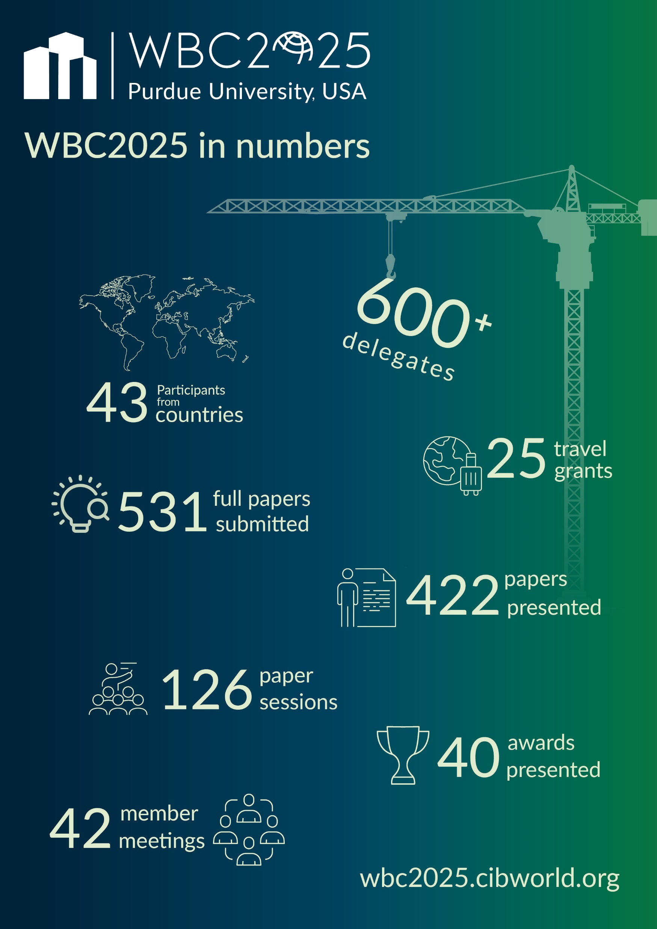
World Building Congress
Held every 3 years
WBC2025 was at Purdue University, West Lafayette, USA
  “The role of the construction community in meeting the UN Sustainable Development Goals”
WBC2028, the 24th WBC will be hosted by
Tsinghua University, Beijing, China,
21st – 26th May 2028
  www.wbc2025.cibworld.org
Notes:
The next WBC will be hosted by Purdue University in the USA from 19-22 May 2025.
Lots more information on the WBC2025 website, and we look forward to seeing you there!

Slide 14
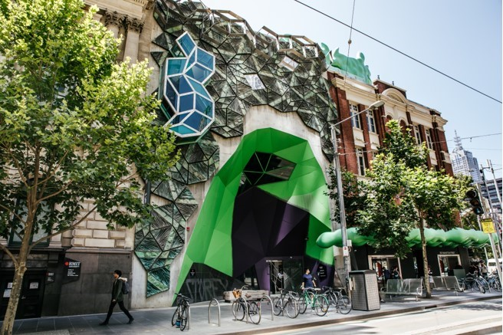
World Building Congresses since 1959
2028 Beijing, China
2025 Purdue, USA
2022 Melbourne, Australia
2019 Hong Kong, China
2016 Tampere, Finland
2013 Brisbane, Australia
2010 Salford, UK
2007 Cape Town, South Africa
2004 Toronto, Canada
2001 Wellington, New Zealand
1998 Gävle, Sweden
1995 Amsterdam, Netherlands
1992 Montreal, Canada
1989 Paris, France
1986 Washington DC, USA
1983 Stockholm, Sweden
1980 Oslo, Norway
1977 Edinburgh, UK
1974 Budapest, Hungary
1971 Paris/Versailles, France
1968 Ottawa/Washington DC, Canada/USA
1965 Copenhagen, Denmark
1962 Cambridge, UK
1959 Rotterdam, Netherlands
Notes:
Every 3 years CIB holds the World Building Congress.
Most of the Working Commissions will hold sessions at the Congress, and it is THE place to be if you are active in research in this sector or interested in innovation.
The most recent event was hosted by RMIT in Melbourne in June 2022, and the Proceedings and session recordings are available from the website.

Slide 15
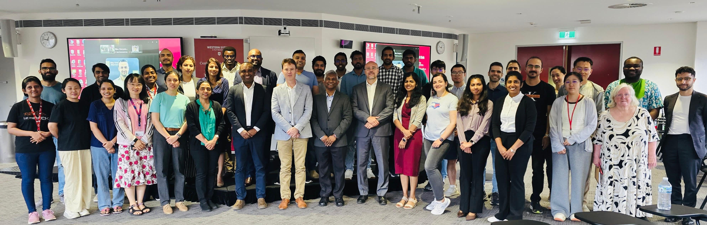
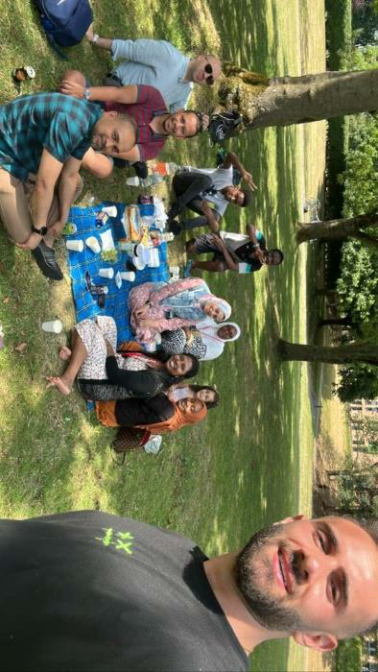
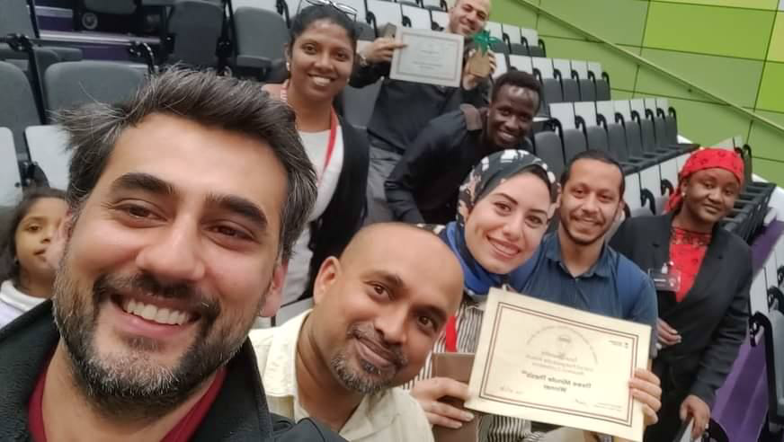
Student Chapters
First founded in 1998, now 26
Regular events including research seminars, professional development, networking
Awards and funding
  Sebestyén Future Leaders Award
  Best Doctoral Research Award
  Vistas funding competition
Notes:
Student Chapters are usually associated with universities and provide a means for students at Doctoral or Masters level to network with their peers including internationally .
- as per slide
More information on the activities of each Chapter can be easily found on the website

Slide 16
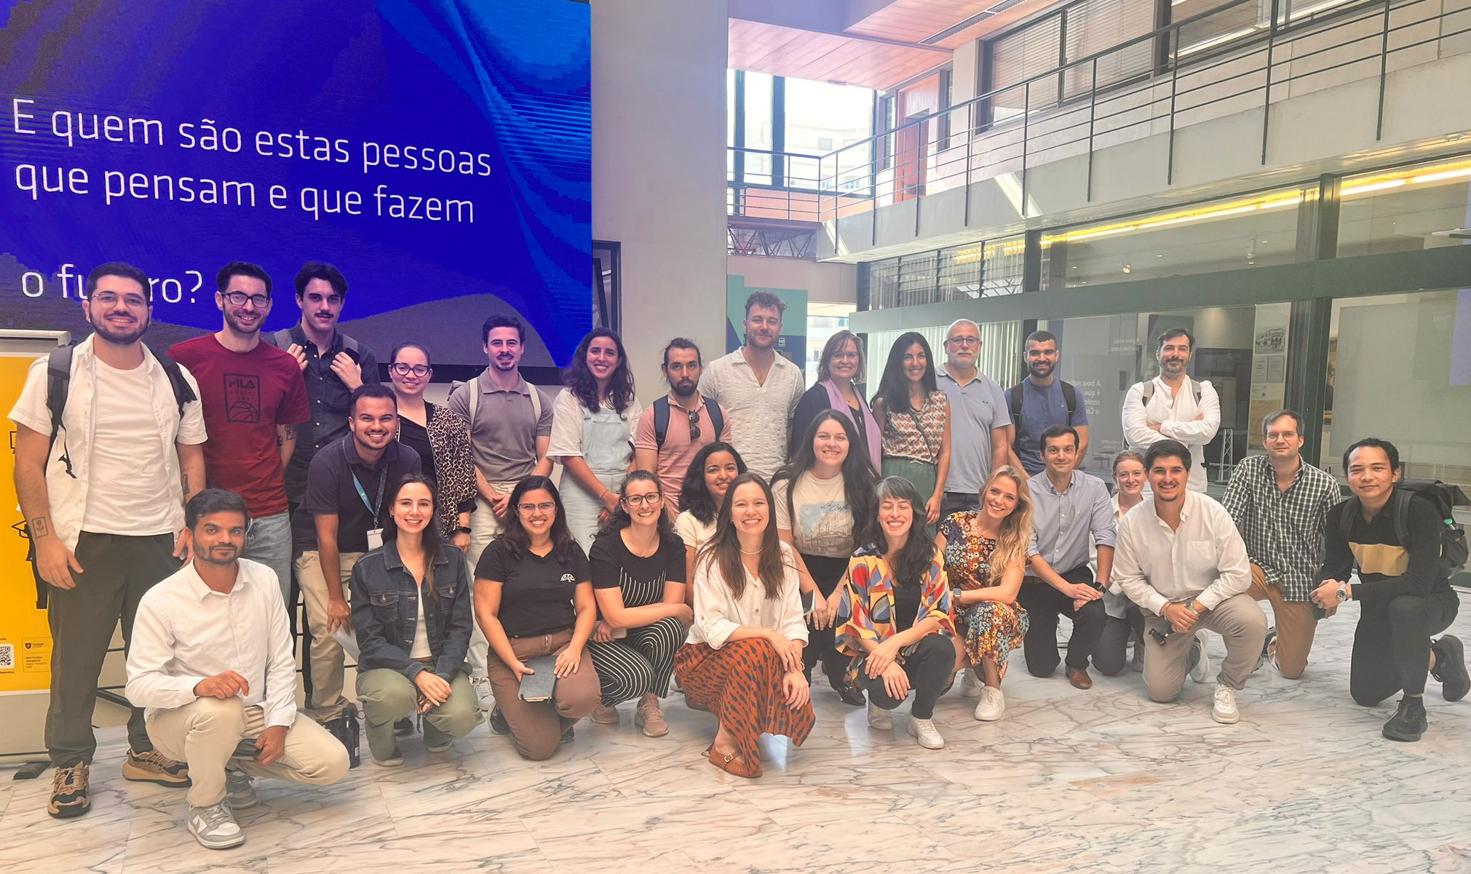
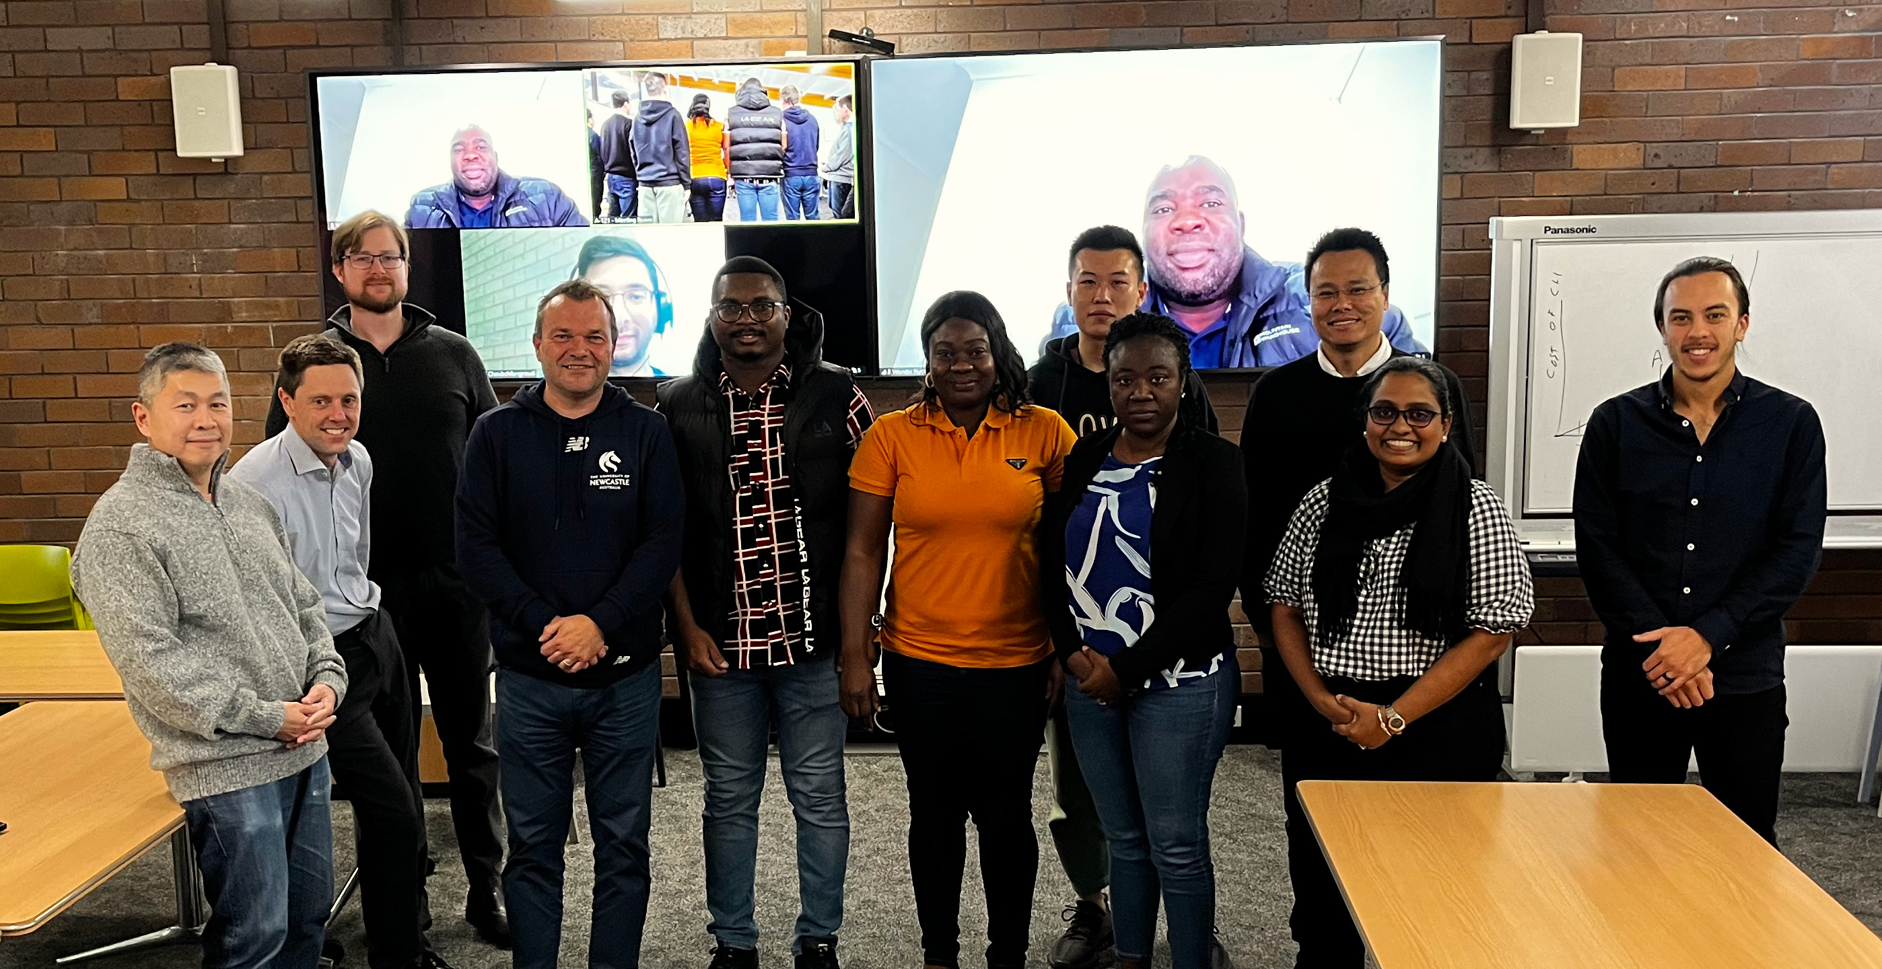
Student Chapters
ASOCSA – Association of Schools of Construction of Southern Africa
Auckland University of Technology, New Zealand
Birmingham City University, UK
City University of Hong Kong
Curtin University, Australia
Hong Kong Polytechnic University, China
Hungarian Student Chapter
Huddersfield University, UK
London South Bank University, UK
Massey University, New Zealand
Nelson Mandela University, South Africa
Newcastle University, Australia
NICMAR University, India
Politecnico Milano, Italy
Purdue University, USA
RMIT University, Australia
Tsinghua University, China
University of Hong Kong, China
University of Moratuwa, Sri Lanka
University of Pretoria, South Africa
University of Salford, UK
University of Wolverhampton, UK
Virginia Tech, USA
Western Sydney University, Australia
W040 Heat and moisture transfer in buildings
W080 Prediction of service life of building materials and components
Notes:
Student Chapters are usually associated with universities and provide a means for students at Doctoral or Masters level to network with their peers including internationally .
- as per slide
More information on the activities of each Chapter can be easily found on the website

Slide 17

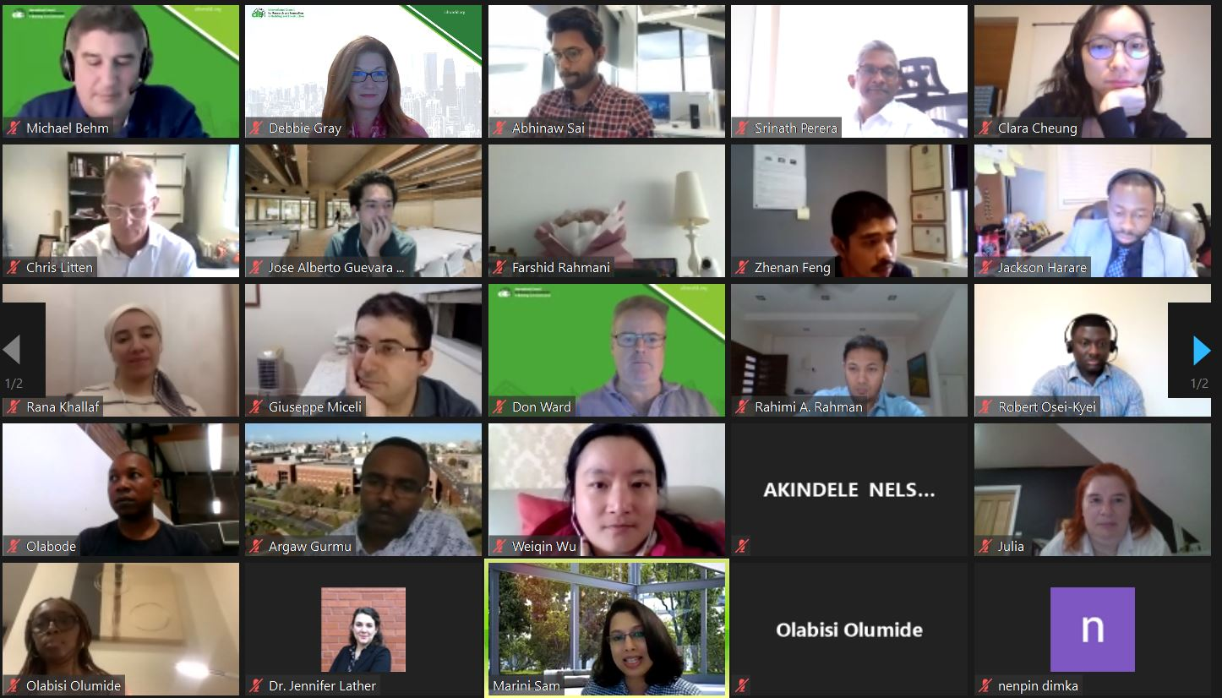
Early Career Researchers, ECR network
Global online network since 2021 supporting early career development, free to join
Engage with discipline-specific
Commissions or Task Groups
Personal development webinars
Awards and funding:
  Keith Hampson ECR-Industry Award
  Makarand Hastak Visiting Global Scholar Award
  Vistas funding competition
Notes:
We think about ECRs as those who are 5 years or less into their career, whether in academia or industry or policy
To enhance their career development, we set up the ECR network in 2021….
- see slide

Slide 18
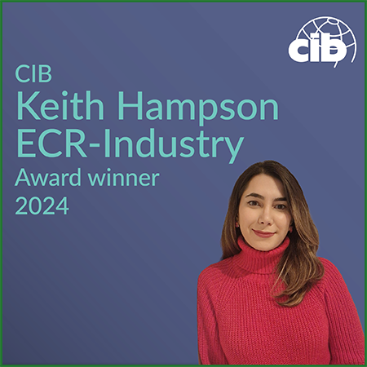
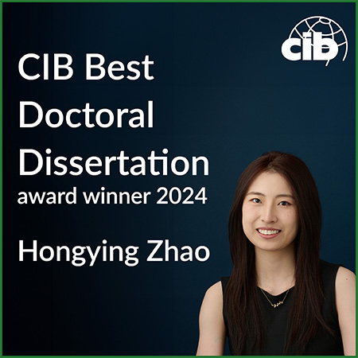
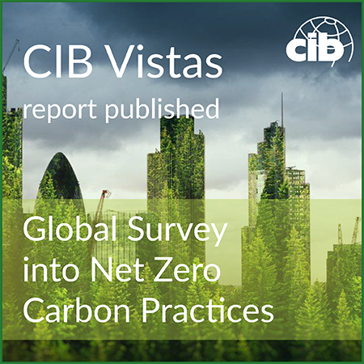
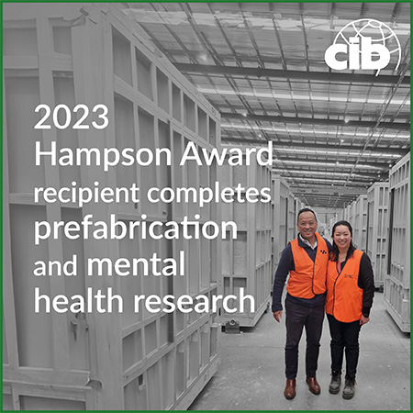
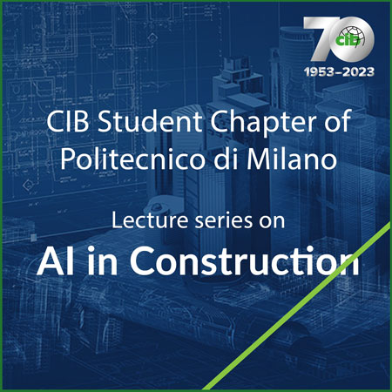
Awards
Sebestyén Future Leaders Award
  €2,500 prize for a CIB Student Chapter to carry out research
  Call for entries in January, deadline end March
Best Doctoral Research Award
  €1,500 prize for the best PhD thesis in the previous 18 months,
  €500 for 2 runners-up
  Call for entries in May, deadline end September
Keith Hampson ECR-Industry Award
  €1,000 prize to promote new and innovative connections between ECRs and the built environment industry
  Call for entries in June, deadline end October
Makarand Hastak Visiting Scholar Award
  €3,000 prize to support and promote collaboration between members in different regions of the world
  Call for entries in April, deadline end May0,
  cibworld.org/student-awards
Notes:
READ TITLES
Vistas is a funding programme not an award as such
The dates when the competition is open are shown here, as are the 3 winners in 2023 on the RHS, congratulations to them all
See https://cibworld.org/student-awards/

Slide 19

Sebestyén Future Leaders Award
Exposing future leaders of the building sector to the latest developments in building research
Award of €2,500 for a CIB Student Chapter to carry out research
2024 winner: Politecnico di Milano
  “Digital Tools for Circular Economy in the Construction Sector”
Next call for entries January 2025
See cibworld.org/student-awards
Notes:
Just a slide now on each of our three main awards aimed at students or ECRs
The first is ….
- see slide

Slide 20
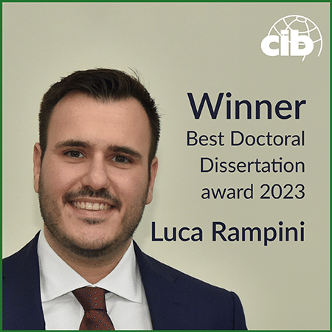
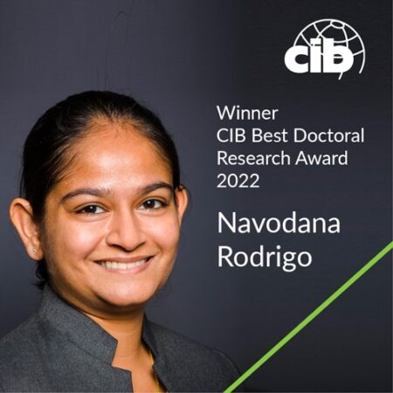
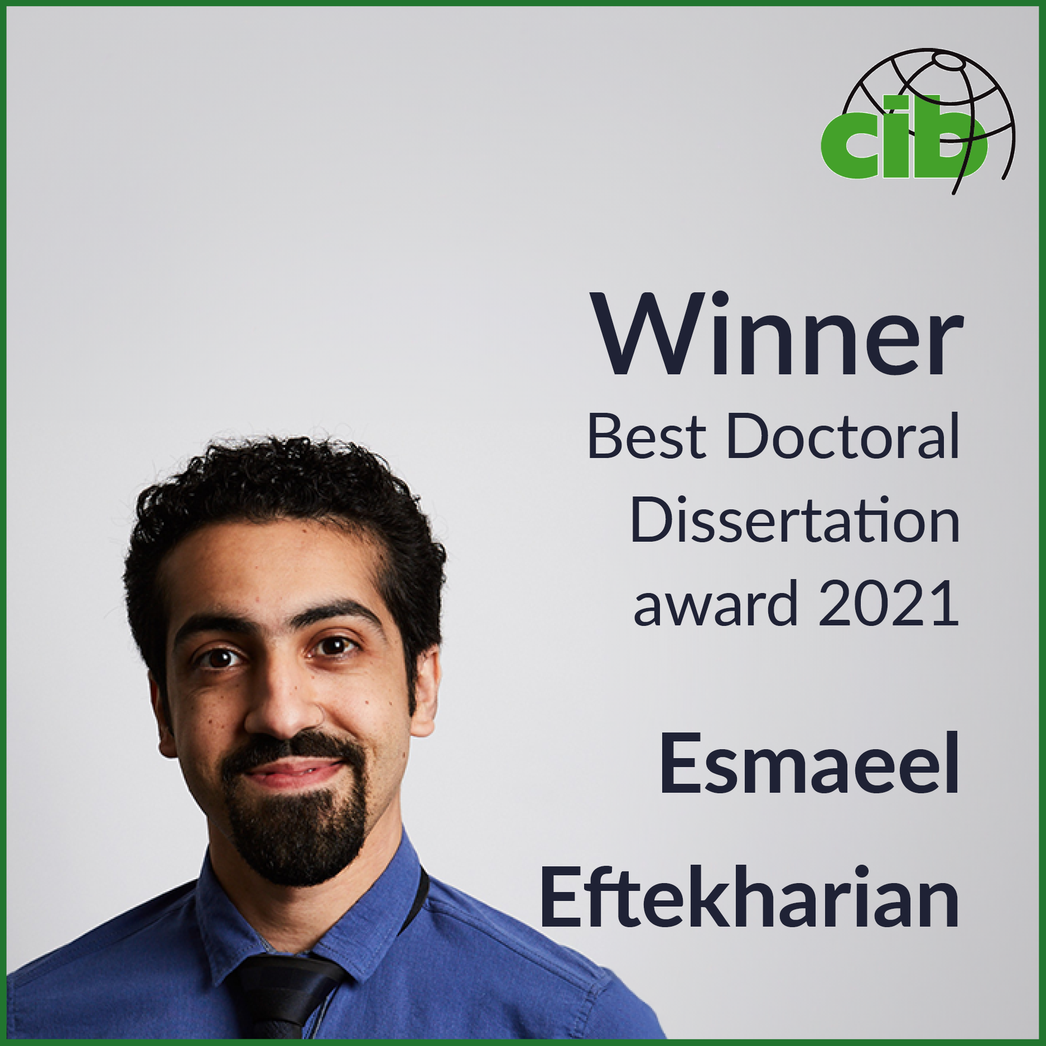
Best Doctoral Thesis Dissertation Award
Annual €1,500 prize for the best global PhD thesis in the previous 18 months, €500 for 2 runners-up
2024 winner:
Dr. Hongying Zhao, RMIT University
  “Energy, Economic and Environmental Performances of BIPV Façade in Urban Environment: a Machine Learning Based Urban Morphology Method”
Next call for entries May 2026,
deadline end September
See cibworld.org/student-awards
Notes:
The Dissertation award was launched in 2021 and look out for the next call for entries in the middle of each year

Slide 21

Keith Hampson ECR-Industry Award
Annual prize of €1,000 to promote new and innovative connections between ECRs and the built environment industry
2024 winner:
Arghavan Akbarieh, Eindhoven University of Technology
  “to further research on creating an AI-driven serious game that supports construction professionals in ISO 19650 standards and openBIM practices”
Next call for entries June 2026,
deadline end September
See cibworld.org/student-awards
Notes:
Our newest award is thanks to the Immediate Past President Keith Hampson who has spent a career working at the nexus of industry and academia
- see slide
More information on all these awards is of course on our website under awards

Slide 22
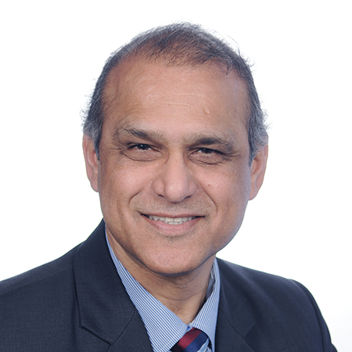
Makarand Hastak Visiting Scholar Award
Annual prize of €3K to support and promote collaboration between members in different regions of the world
Call for entries April 2026, deadline end May
Makarand, Mark Hastak
Purdue University USA
CIB President 2022-2025
Notes:
Our newest award is thanks to the Immediate Past President Keith Hampson who has spent a career working at the nexus of industry and academia
- see slide
More information on all these awards is of course on our website under awards

Slide 23












Membership
Over 80 corporate members, 75% universities, over 3000 experts
From 60 different countries
Targeting growth
developing and under-represented countries
industry innovators
research funders and policy-makers

Slide 24
CIB members 2026
Full members
BRANZ – Building Research Association of New Zealand
Buildwise
EMI, Non-Profit Limited Liability Company for Quality Control and Innovation in Building
Glodon Co. Ltd (Beijing)
Massey University
National Research Council Canada
National Research Council of Italy
RMIT University
SBEnrc/Curtin University
Shanghai Research Institute of Building Sciences
South African Council for Project and Construction Management Professions (SACPCMP)
TNO Built Environment
Associate members – Research Institutes & Industry
Architecture and Building Research Institute – Ministry of the Interior Taiwan
Competence Center Typology and Planning in Architecture, CCTP
Construction Research Institute of Malaysia (CREAM)
Council of Registered Builders of Nigeria
DGNB - German Sustainable Building Council
European Construction and sustainable built environment Technology Platform, ECTP
Fraunhofer Information Center for Planning and Building IRB
Granlund
Institute of Technology Sepuluh Nopember
Instituto de Pesquisas Tecnologicas do Estado de Sao Paulo – IPT
Instituto Superior Técnico, IST
International Code Council
Kashiwagi Solution Model Incorporated
National House Building Regulation Council (NHBRC)
RIL – Finnish Association of Civil Engineers
RISE Research Institutes of Sweden
Spanish Council for Scientific Research
– Eduardo Torroja Institute for Construction Science
Notes:
New members in 2025 are highlighted

Slide 25
Associate members – Universities
Aalborg University
Anglia Ruskin University
Auburn University
Auckland University of Technology
Birmingham City University
Central South University
Chang’an University
Chongqing University
Delft University of Technology
DTU – Technical University of Denmark
Georgia Tech
Glasgow Caledonian University
Heriot-Watt University
Hong Kong Polytechnic University
Istanbul Technical University
Kwame Nkrumah University of Science and Technology
Lappeenranta–Lahti University of Technology (LUT)
Leeds Beckett University
Liverpool John Moores University
London South Bank University
Loughborough University
Middle East Technical University
National Taiwan University of Science and Technology
Nelson Mandela Metropolitan University
NICMAR University
Northumbria University
Norwegian University of Science and Technology
Nottingham Trent University
Oxford Brookes University
Politecnico di Milano
Purdue University
Southeast University
Sustainability Orientated Cyber research Unit for the Built Environment, S⊕CUBE
Tampere University Foundation
Technological University Dublin
Torrens University Australia
Tsinghua University
University of Adelaide
University of Hong Kong
University of Johannesburg
University of Lagos
University of Melbourne
University of Moratuwa
University of New Brunswick
University of Newcastle
University of Pretoria
University of Reading
University of Salford
University of São Paulo
University of South Africa, UNISA
University of Technology Sydney
University of the Witwatersrand
University of Washington
University of Wolverhampton
University of Zagreb
Virginia Tech
Western Sydney University
Individual members
80 Individual and ECR members
Notes:
New members in 2025 are highlighted

Slide 26
Participation in CIB enables:
International positioning and credibility
Demonstrating connection to a recognised global community shaping the field
Collaboration and opportunity development
Creating structured routes to partnerships, joint work and future opportunities
Influence and contribution
Participating in shaping agendas, themes and sector direction
Talent and capability development
Developing researchers, professionals and future leaders
Access to platforms and knowledge
Engaging with expert groups, conferences, publications and global activity

Slide 27
CIB governance
Board
Officers Committee
Administration Committee
Future Leaders Committee
CEO and Secretariat
AIBC
(operating company
Membership and Communications Committee
Programme Committee
Working Commissions
Task Groups
Student
Chapters
ECR network
General Assembly

Slide 28







CIB Officers 2025-2028
President
Dongping Fang
Tsinghua University, China
Vice President
Ron Wakefield
RMIT University, Australia
Vice President
Piia Sormunen
Tampere University, Finland
Treasurer
Anil Kashyap
India
Programme Committee Chair
Kim Haugbølle
Aalborg University, Denmark
Membership & Communications Committee Chair
Georg Reichard
Georgia Tech, USA
Future Leaders
Committee Chair
Srinath Perera
Western Sydney University, Australia
Immediate Past President
Makarand (Mark) Hastak
Purdue University USA
Notes:
These are the current Officers.
The President is Makarand Hastak.

Slide 29

Other Board members 2025-2028
15 countries, 6 continents - 8 Officers plus:
Chris Allen
Nelson Mandela University, South Africa
Marianne Armstong
NRC, Canada
Bart Bleys
Buildwise, Belgium
Taha Elhag
Heriot-Watt University, Dubai, UAE
Claire Falck
BRANZ, New Zealand
Billy Hare
Glasgow Caledonian University, UK
Huub Keizers
TNO, Netherlands
Brian Kleiner
Virginia Tech, USA
Kathy Michell
Sustainability Orientated Cyber research Unit for the Built Environment, S⊕CUBE, South Africa
Geoffrey Shen
Hong Kong Polytechnic University, China
Monty Sutrisna
Massey University, New Zealand
Janne Tahtikunnas
RIL - Finnish Association of Civil Engineers, Finland
Anita Terjék
ÉMI, Hungary
Eduardo Toledo Santos
University of São Paulo - Escola Politécnica, Brazil
Patricia Tzortzopoulos
Nottingham Trent University, UK
Notes:
Overall the Board comprises up to 25 people including Officers
At this time they come from 18 different countries across 6 continents

Slide 30
UN Sustainable Development Goals 2015
Notes:
Given our long association with the United Nations, it is important for CIB to adopt the framework of the UN SDGs…
- highlight groups of the SDGs where our sector makes a positive or negative impact
In summary, our sector has a huge part to play in progressing towards these goals, in terms of improving our processes and our products.
Research and innovation will be key to such progress.

Slide 31


Thank you
Don Ward, Chief Executive
don.ward@cibworld.org
www.linkedin.com/in/don-ward-8203269/
www.cibworld.org
Notes:
So I hope this overview has been helpful.
Much more information about all aspects of our work is available on the website, including a copy of this slide deck if you wish to download a copy.
if you have any questions or wish to get involved, please contact secretariat@cibworld.org and someone will be in touch promptly.
Thank you for watching and listening

