Slide 1
Improving research globally
Don Ward
CIB Chief Executive
August 2024
www.cibworld.org
Notes:
Hello, I’m Don Ward, CEO of CIB since 2020
Welcome to this short overview of CIB

Slide 2
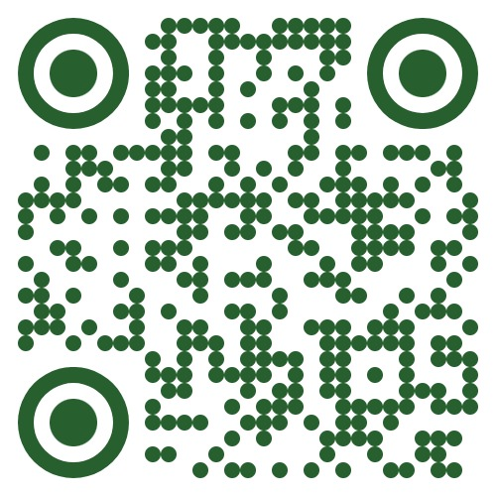




The global network for
    Collaboration for
    Innovation in the
    Built environment
    International Council for
    Research and Innovation in
    Buildings and Construction
Notes:
CIB is the global network which stands for…

Slide 3

Our history
Established in 1953 as an NGO on the initiative of the United Nations
Conseil International du Bâtiment
pour la recherche, l'étude et la documentation
A global association with worldwide membership
“To support an improved building process and enhanced performance of the built environment”
Notes:
CIB is over 70 years old and was originally named in French…

Slide 4


70 years of international cooperation to build a more sustainable world
Notes:
This commemorative brochure marks the 70th anniversary of CIB

Slide 5
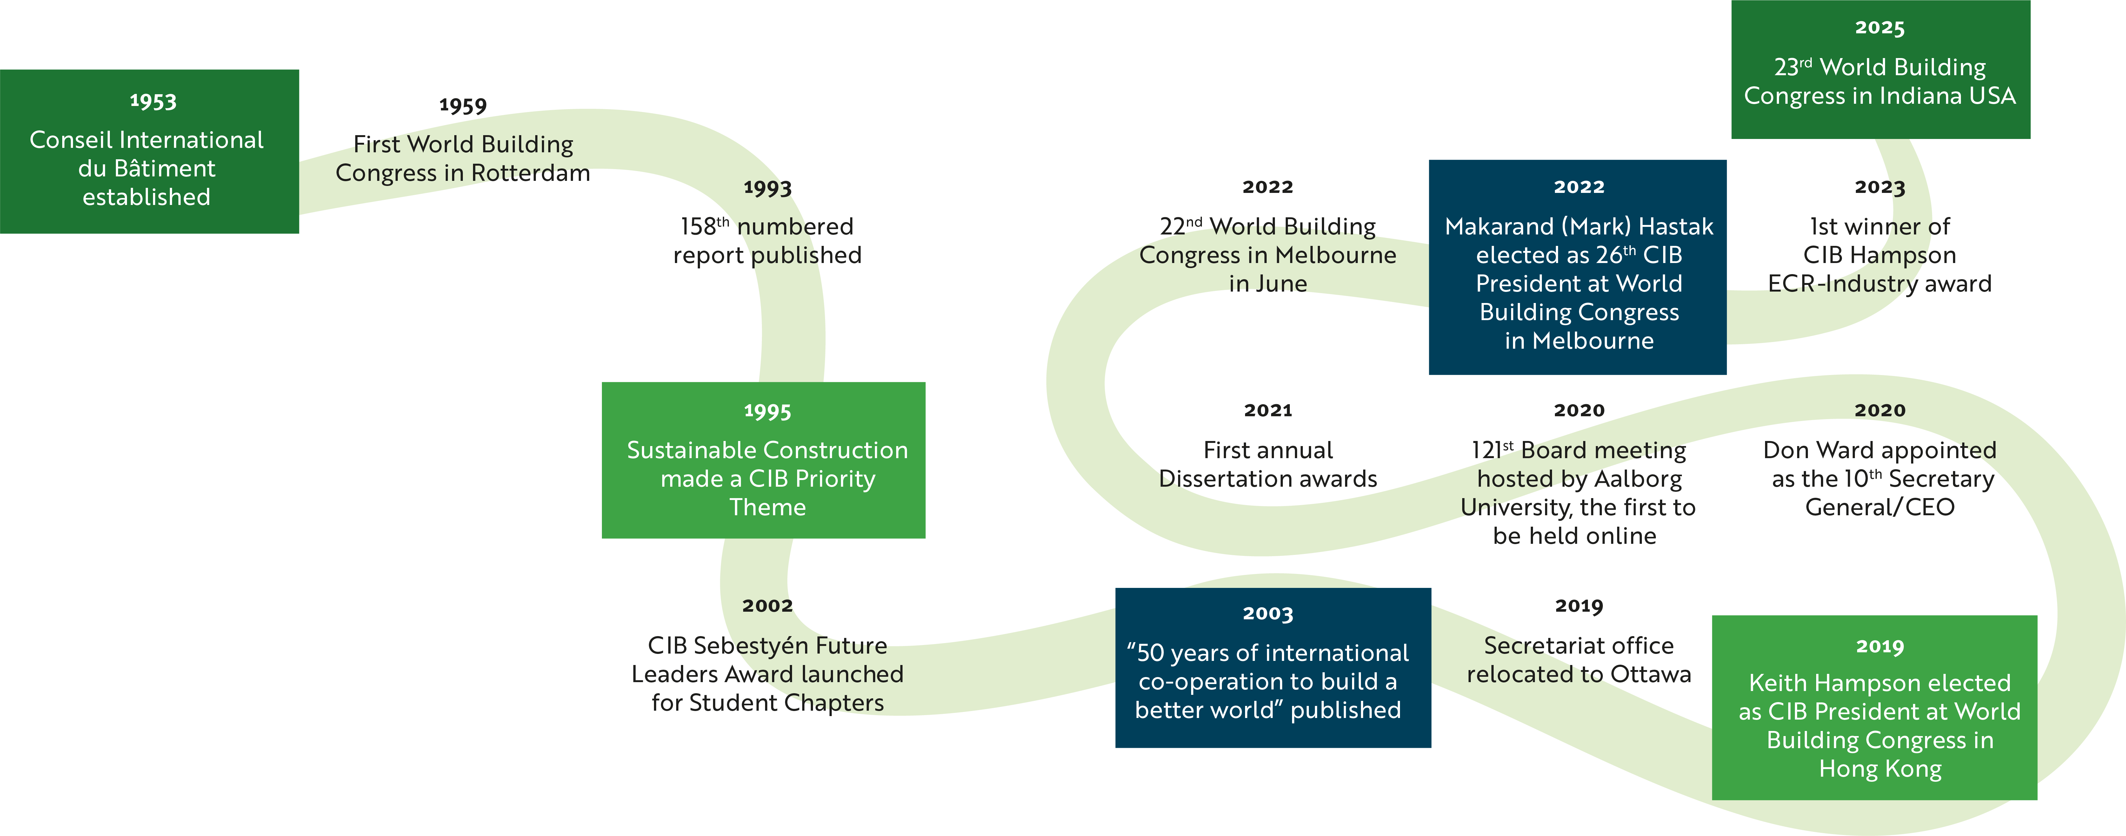
History
Notes:
This timeline shows some of the major milestones for CIB in those 70 years

Slide 6

CIB’s objectives
Provide a global network for international exchange and cooperation in building and construction research and innovation
Improve the performance of research and researchers through meeting, sharing and learning
Make the sector’s knowledge available, and bridge the gap between research and implementation in the industry
Promote the value of research as a vital contributor to industry development, societal growth and environmental sustainability
Notes:
CIB has 4 main objectives to add value for innovation in our sector

Slide 7
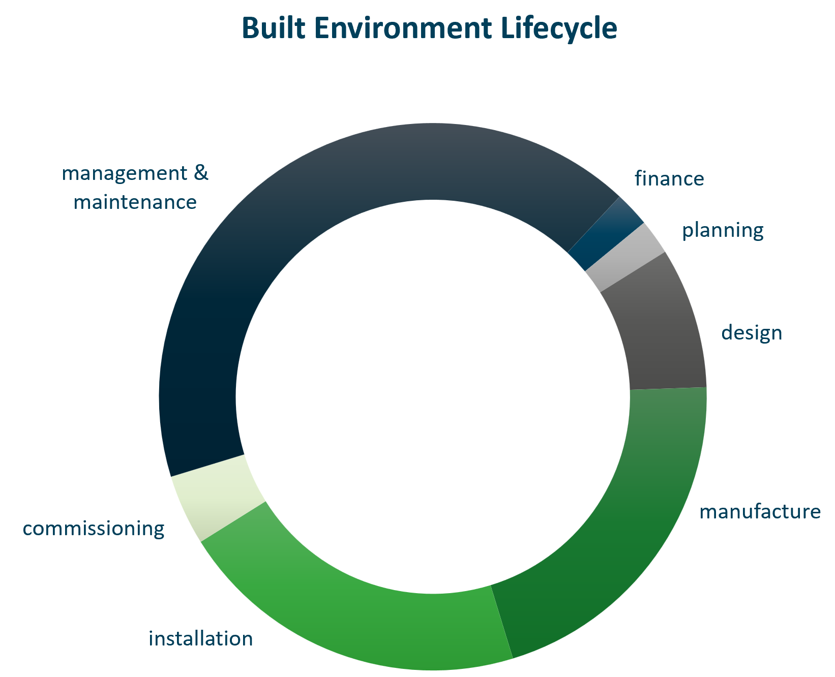
Scope
Includes technical, economic, social, environmental, organizational factors
All stages of the built environment life cycle
Whole innovation process of basic and applied research, documentation and transfer of research results, and implementation
Notes:
CIB’s scope covers all stages of built environment, from its design and construction to its operation and renewal
It also covers the full range of R&I activities from pure research to commercial innovation

Slide 8
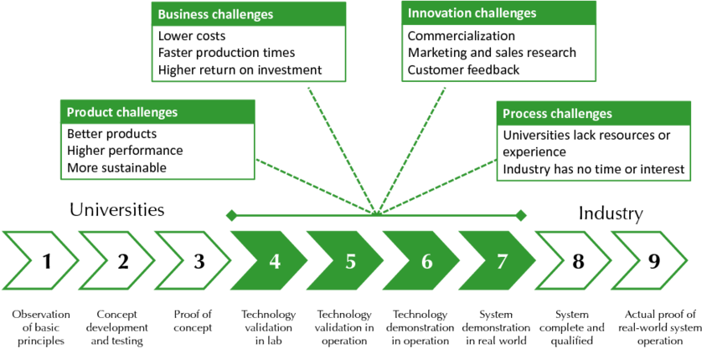
Technical Readiness Levels (unlikely to use)

Slide 9
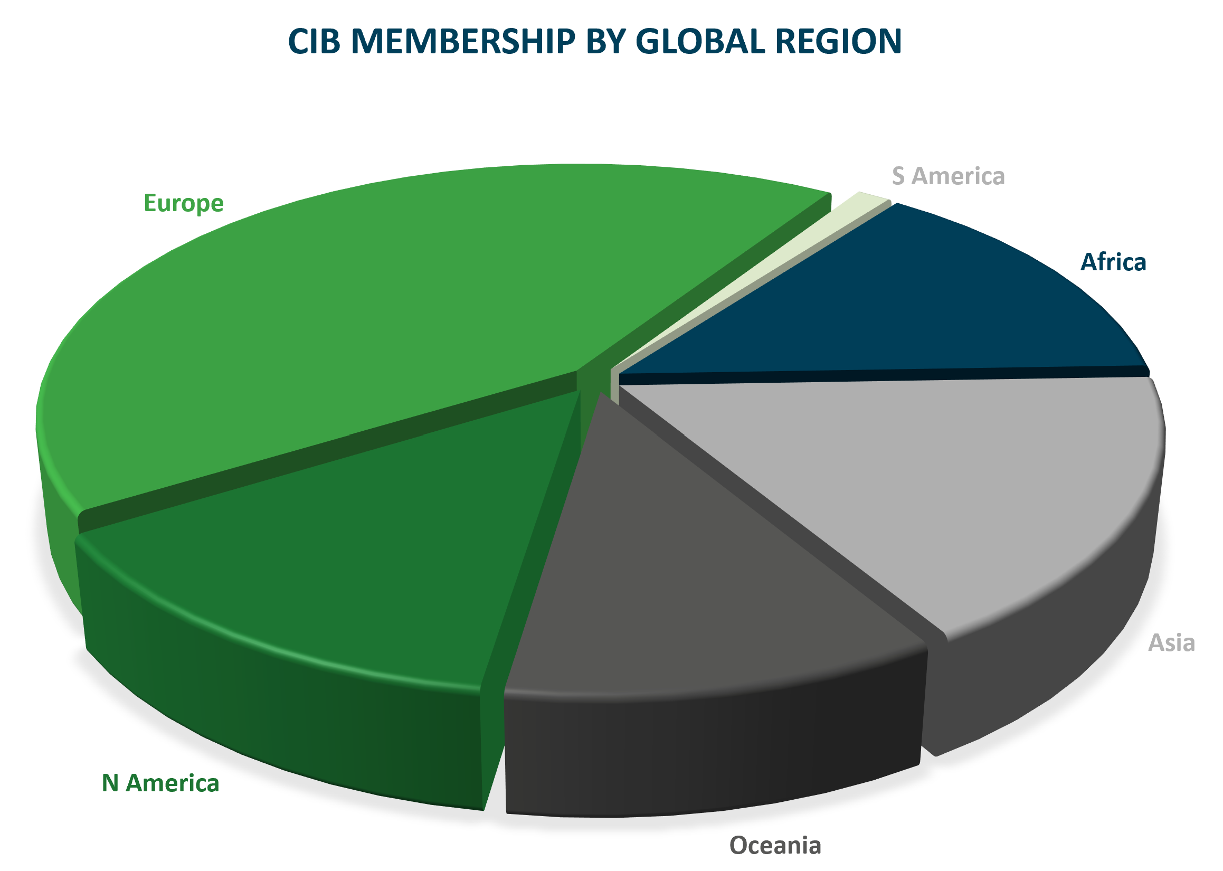










Membership
Over 100 corporate members, 75% universities, over 3000 experts
Targeting growth in developing and under-represented countries, industry innovators, research funders and policy-makers

Slide 10
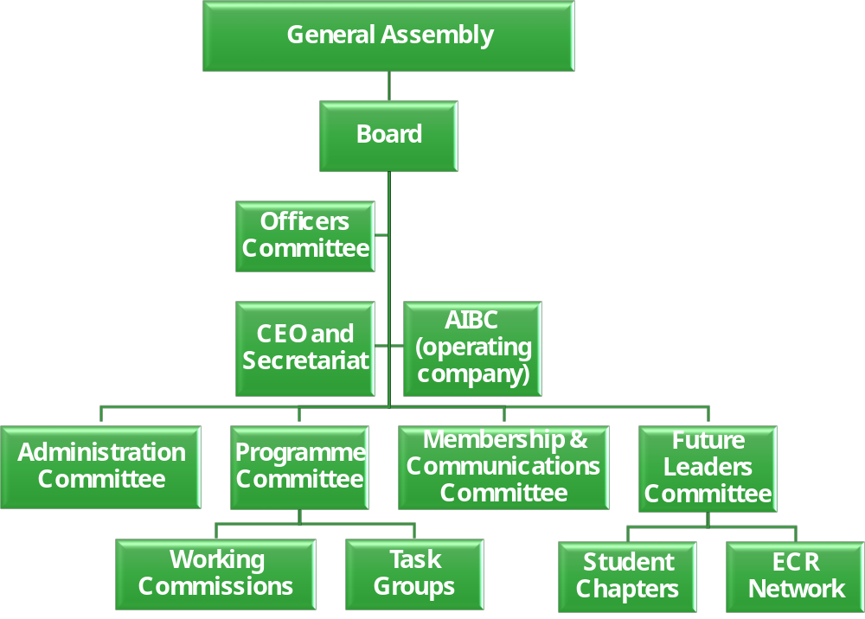
CIB governance
Don Ward, CEO
Theo Haupt, Programme Director
Sina Moradi, Programme Manager
Eira Rowe, Communications Director
Notes:
The GA is held each year in May/June, as well as presenting the annual report to the membership, every 3 years the GA elects the Board, which is the main governing body
The Board has a number of Committees, supported by the CEO and the secretariat, who look after the key aspects of CIB’s programme of work, namely the Membership, Commissions and Task Groups, and the Student Chapters and ECR network.

Slide 11
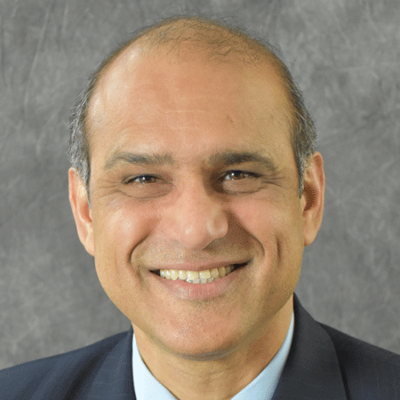
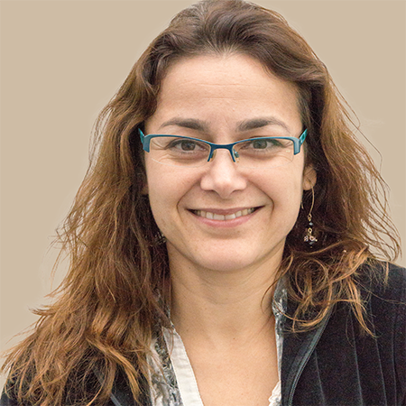
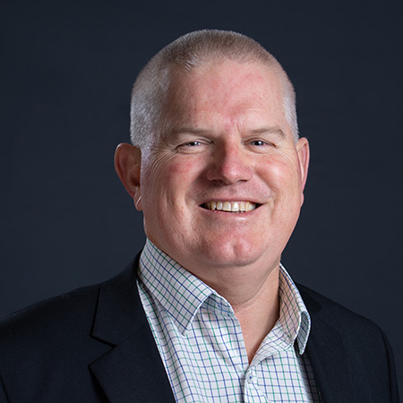
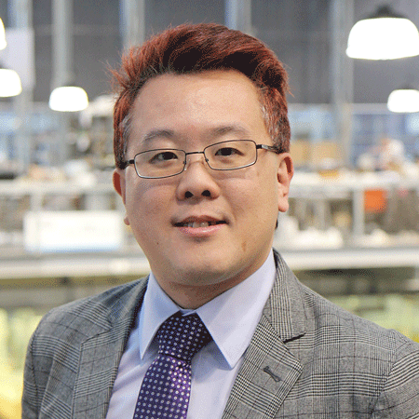
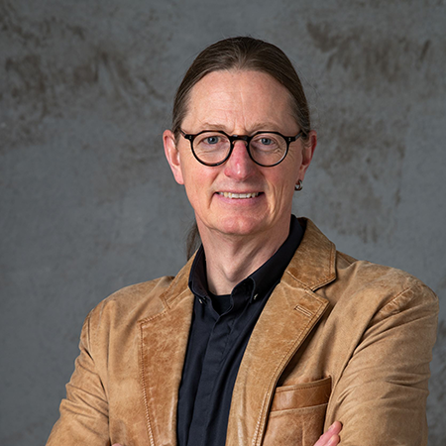
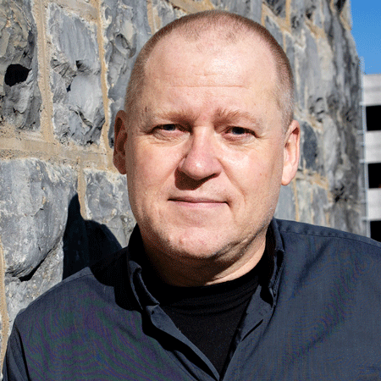
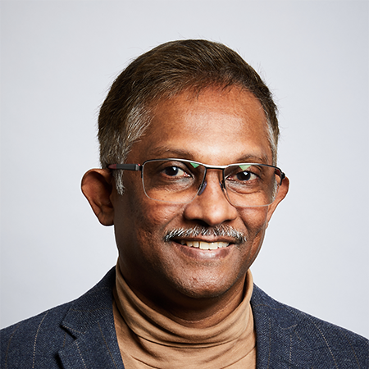
CIB Officers
President
Makarand (Mark) Hastak
Purdue University USA
Vice President
Patricia Tzortzopoulos Fazenda,
University of Huddersfield, UK
Vice President
Ron Wakefield
RMIT University, Australia
Treasurer
Paul Chan
TU Delft, Netherlands
Programme Committee Chair
Kim Haugbølle
Aalborg University, Denmark
Membership & Communications Committee Chair
Georg Reichard
Virginia Tech, USA
Future Leaders
Committee Chair
Srinath Perera
Western Sydney University, Australia
Notes:
These are the current Officers.
The President is Makarand Hastak.

Slide 12


CIB Board members
18 countries, 6 continents - 7 Officers plus:
Wayne Draii
Nelson Mandela University, South Africa
Taha Elhag
Heriot-Watt University (Dubai), UAE
Hisham Elkadi
University of Salford, UK
Dongping Fang
Tsinghua University, China
Bart Ingelaere
Buildwise, Belgium
Huub Keizers
TNO, Netherlands
Thomas Kirmayr
Fraunhofer Information Center
for Planning and Building IRB, Germany
Michael Lacasse
NRC, Canada
Göran Lindahl
Chalmers University of Technology, Sweden
Kathy Michell
University of Cape Town, South Africa
Piia Sormunen
Tampere University Foundation, Finland
Monty Sutrisna
Massey University, New Zealand
Janne Tahtikunnas
RIL - Finnish Association of Civil Engineers, Finland
Anita Terjék
ÉMI, Hungary
Eduardo Toledo
University of São Paulo - Escola Politécnica, Brazil
Tarek Zayed
Hong Kong Polytechnic University, China
Notes:
Overall the Board comprises up to 25 people including Officers
At this time they come from 18 different countries across 6 continents

Slide 13
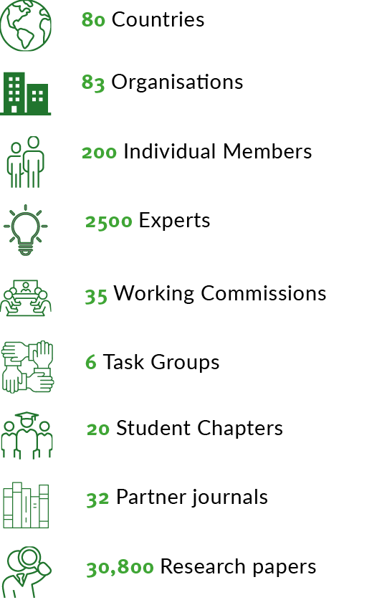
Adding value for global research
Global network for collaboration
  41 expert Working Commissions & Task Groups
  Conferences, webinars, publications, 32 partner journals, research roadmaps, research database (30,000 papers)
  World Building Congress 2025
Supporting tomorrow’s talent
  20 Student Chapters
  New global network for Early Career Researchers
  Awards
  CIB on YouTube (@CIBSecretariat)
Campaigning on issues which matter, eg
impact, research classification
Notes:
CIB adds value in 3 main ways….

Slide 14
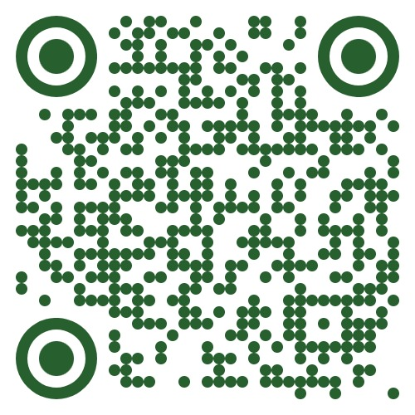
Working Commissions and Task Groups (2024)
Architectural Design and Management
Building Pathology
Clients and Users in Construction
Construction in Developing Countries
Construction Industry Economics
Construction Materials Stewardship
Creating An Inclusive Built Environment for Diverse Users’ Needs
Culture in Construction
Customised Industrial Construction
Disasters and the Built Environment
Education in the Built Environment
Facilities Management and Maintenance
Fire Safety
Global Construction Data
Heat and Moisture Transfer in Buildings
Informal Settlements and Affordable Housing
Information and Knowledge Management in Building
Information Technology for Construction
Innovation in Construction
Intelligent and Responsive Buildings
Law and Dispute Resolution
Nature Based Solutions for Climate Resilient Buildings and Communities
Offsite Construction
Open Building Implementation
Organisation and Management of Construction
People in Construction
Performance Measurement in Construction
Prediction of Service Life of Building Materials and Components
Procurement Systems
Public Private Partnerships
Residential Studies
Roofing Materials and Systems
Safety and Health in Construction
Sandwich Panels
Smart and Sustainable Built Environments
Spatial Planning and Infrastructure Development
Usability of Workplaces
Wall Structures
Water Supply and Drainage
Zero-Carbon
Building & Infrastructure
Design and Construction
Notes:
The Working Commissions and Task Groups are the core of our work, and here is the list as of mid 2024.
The topic coverage is not exhaustive, but the groups cover most of the crucial topics for improving our industry, and where current research is most active
You can dig deeper into the activities of each of these Commissions on the website.
Members may propose topics for new Task Groups at any time.
In recent times the agenda of sustainable development, social as well as environmental, has been increasingly reflected in the focus of new groups.
- Change which ones are highlighted depending on the audience

Slide 15
UN Sustainable Development Goals 2015
Notes:
Given our long association with the United Nations, it is important for CIB to adopt the framework of the UN SDGs…
- highlight groups of the SDGs where our sector makes a positive or negative impact
In summary, our sector has a huge part to play in progressing towards these goals, in terms of improving our processes and our products.
Research and innovation will be key to such progress.

Slide 16



Vistas
Global
collaboration
Futures
People and the planet
Notes:
We use the framework of CIB vistas to communicate the value of the CIB’s Commissions and other activities
We also run a funding competition each year for research by our members under these headings

Slide 17
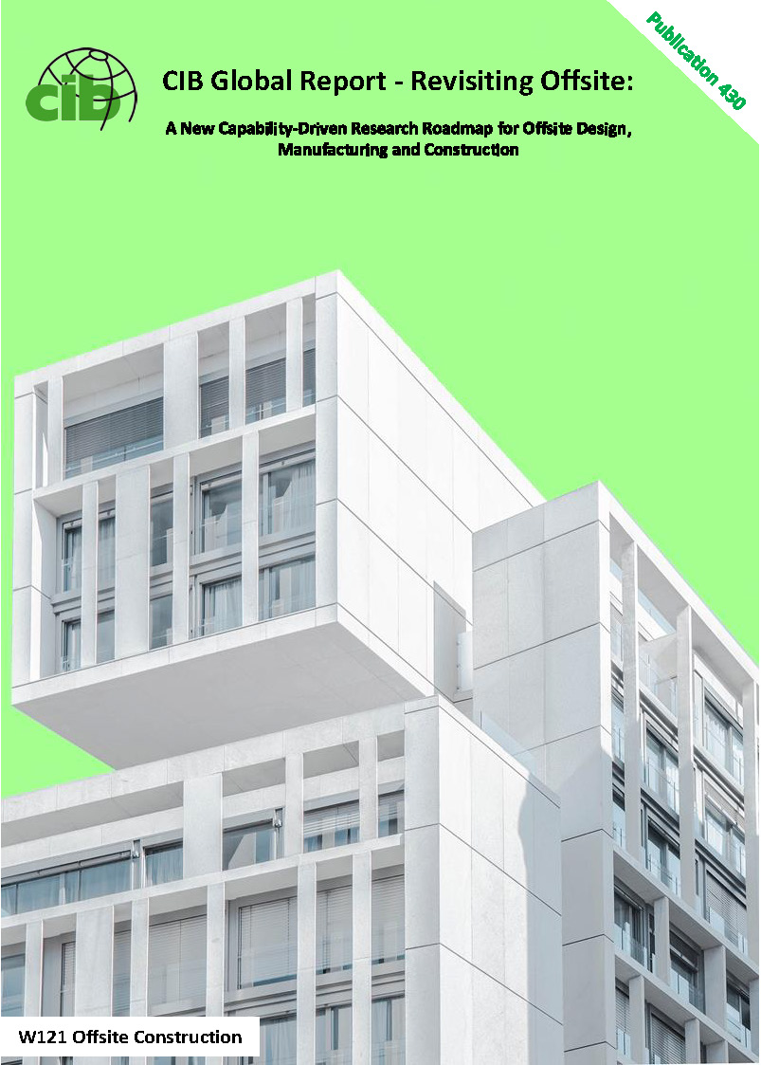
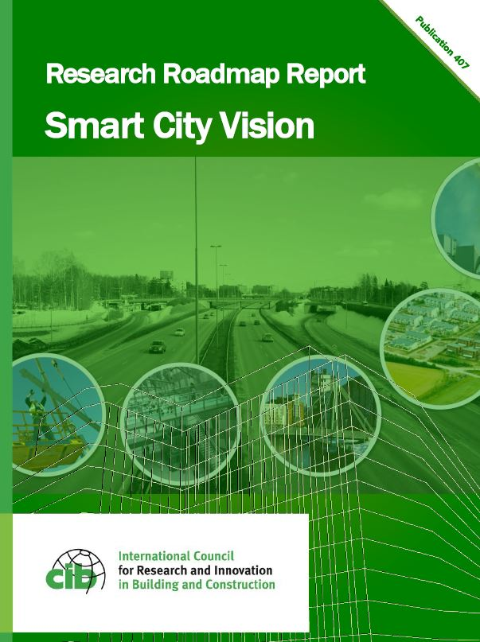
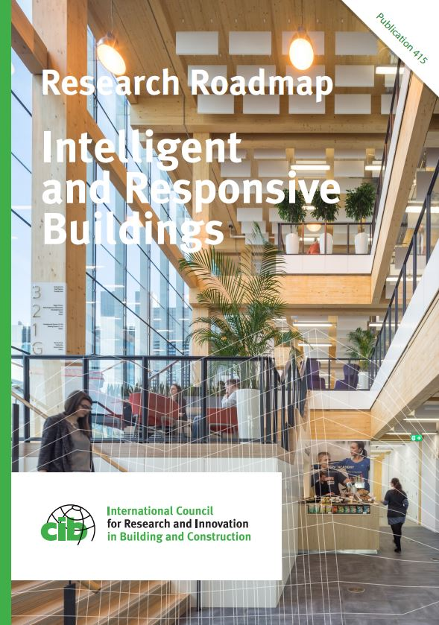
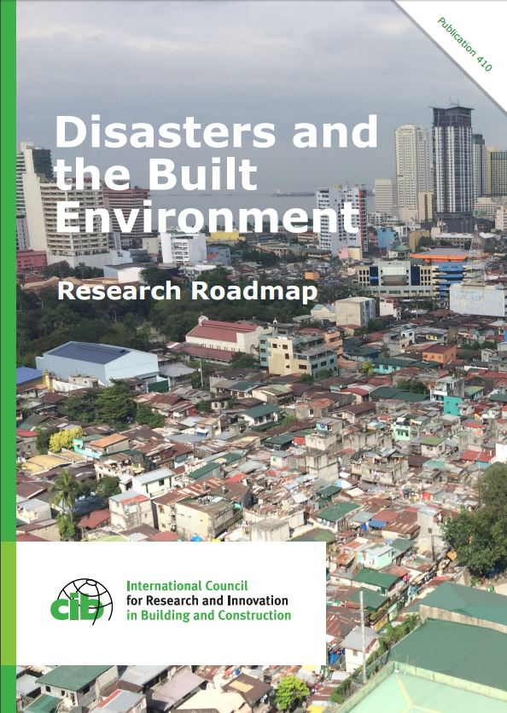
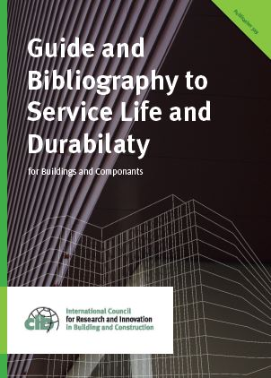

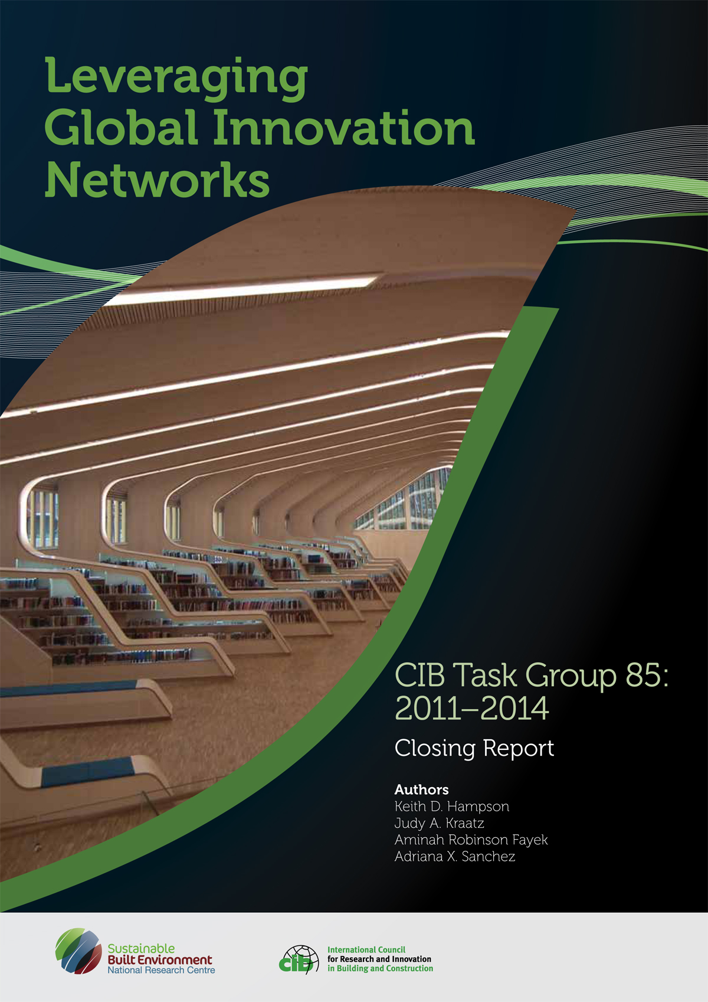
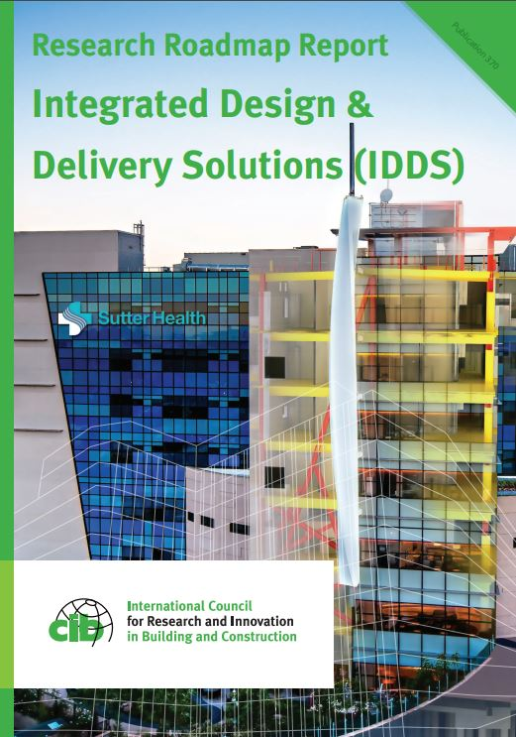
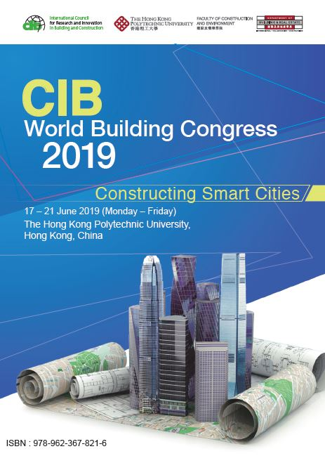



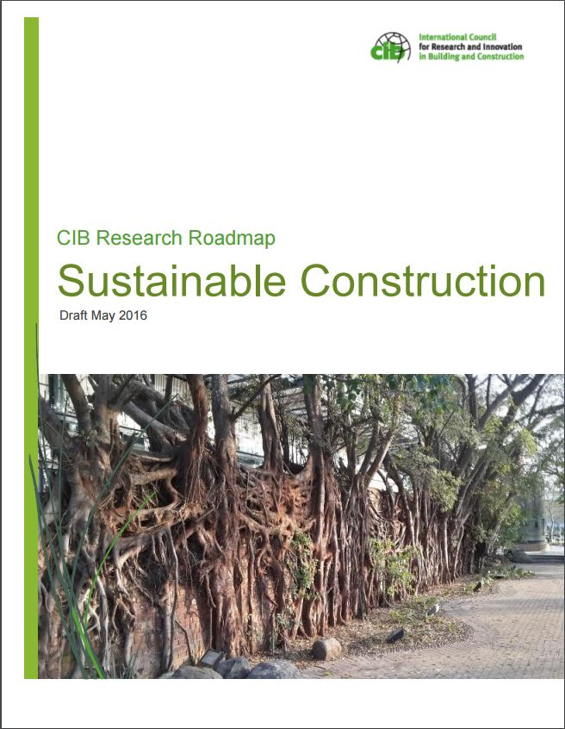
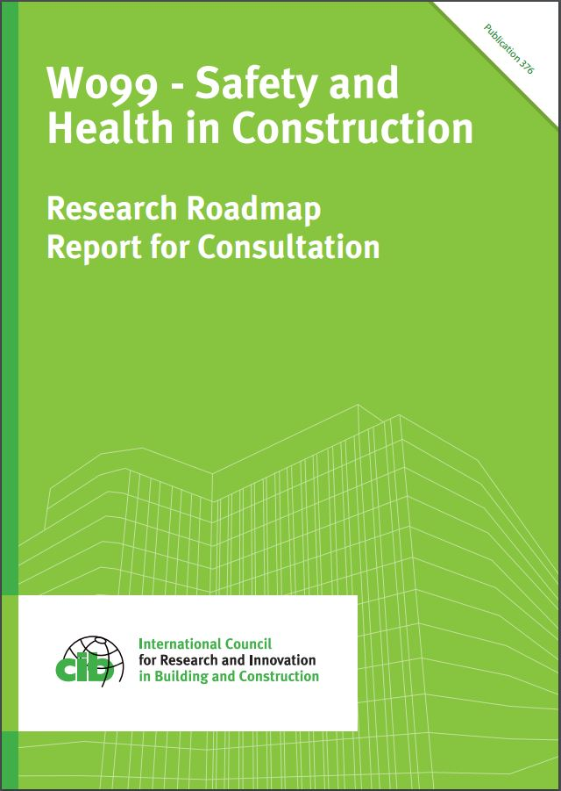
Publications
Notes:
CIB’s Commissions and Task Groups provide a range of reports and publications, including research roadmaps setting out the future research agenda

Slide 18


Partner journals
CIB Recognised Journals (3)
Building Research & Information (BR&I) - Taylor and Francis (Informa)
Built Environment Project and Asset Management (BEPAM) - Emerald
Construction Management and Economics (CM&E) - Taylor and Francis (Informa)
CIB Encouraged Journals (29)
Advancement of Performance Information & Value, Journal for - Kashiwagi Solution Model, Inc.
Architectural Engineering and Design Management - Taylor and Francis (Informa)
Architecture Science (ArS) - Architectural Institute of Taiwan
Building Pathology and Adaptation, International Journal of (IJBPA) - Emerald
Building Physics, Journal of - SAGE
Buildings - MDPI
Buildings & Cities - Ubiquity Press
Civil Engineering and Management, Journal of - Taylor & Francis (Informa)
Construction Economics and Building, Journal of - UTS ePRESS
Construction in Developing Countries, Journal of - Penerbit Universiti Sains Malaysia
Construction Innovation: Information, Process, Management (CI) - Emerald
Construction Management, International Journal of - Taylor and Francis (Informa)
Disaster Resilience in the Built Environment, International Journal of (IJDRBE) - Emerald
Engineering, Construction and Architectural Management (ECAM) - Emerald
Engineering, Design and Technology, Journal of (JEDT) - Emerald
Facilities - Emerald
Financial Management of Property and Construction, Journal of (JFMPC) – Emerald
Frontiers in Built Environment – Frontiers
Informes de la Construcción - CSIC
Intelligent Buildings International - Taylor and Francis (Informa)
ITcon – Journal of Information Technology in Construction
Management, Procurement and Law - ICE
Materiales de Construcción - CSIC
Open House International (OHI) - Emerald
Property Planning and Environmental Law, Journal of (JPPEL) - Emerald
Revista Ingeniería de Construcción (Journal of Construction Engineering) - Department of Engineering and Construction Management of the Pontificia Universidad Católica de Chile
Smart and Sustainable Built Environment (SASBE) - Emerald
Smart Cities - MDPI
Sustainability - MDPI

Slide 19
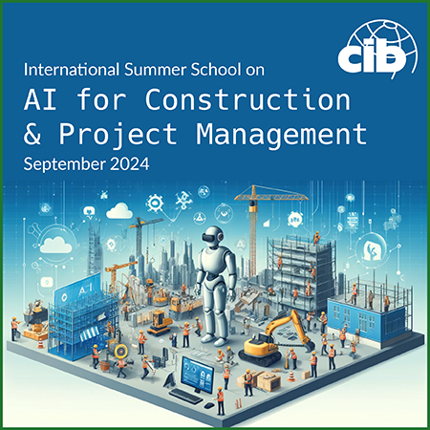
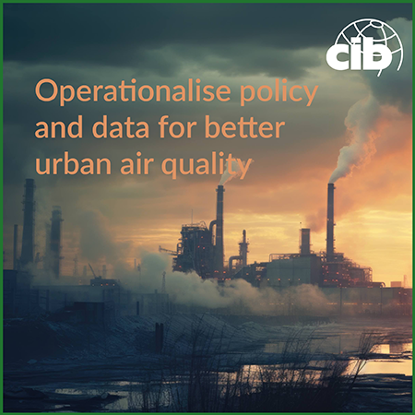


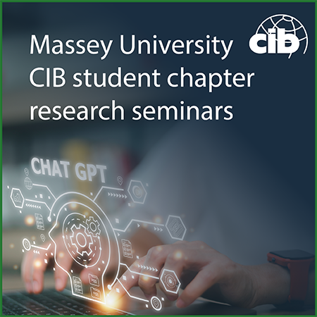

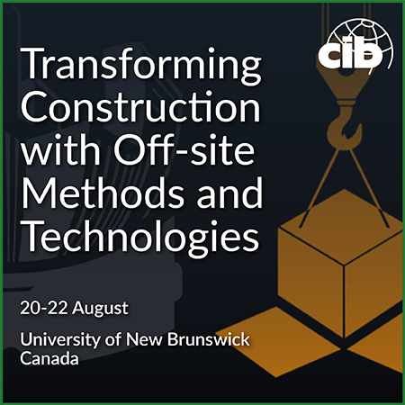


Events
CIB W099 & W123 conference on Digital Transformation of Health and Safety in Construction, Porto, Portugal, June 2023
CIB W070 Conference on Facility Management and Maintenance, Trondheim, Norway, May 2023
World Building Congress 2022 (WBC2022), hosted by RMIT, Melbourne, Australia, June 2022
CIB TG96 Smart Built Environment Conference 2021, December 2021
CIB W099 & TG59 International Web-Conference 2020: Good Health, Wellbeing & Decent Work, September 2020
Notes:
CIB’s Commissions also host conferences for research members and others to come together to share their work, network and collaborate

Slide 20
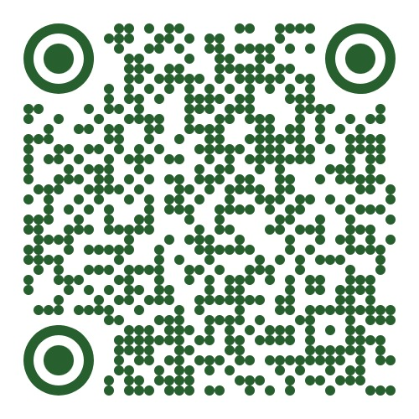
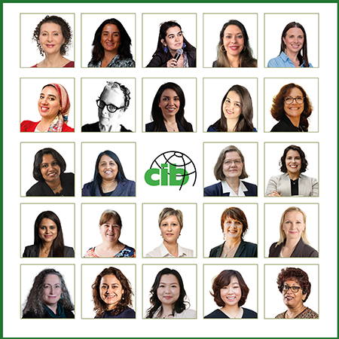
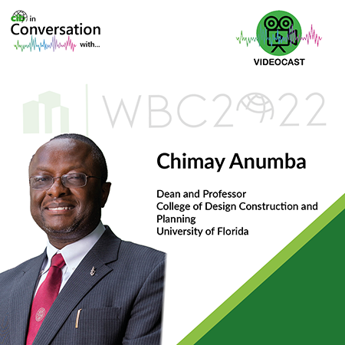
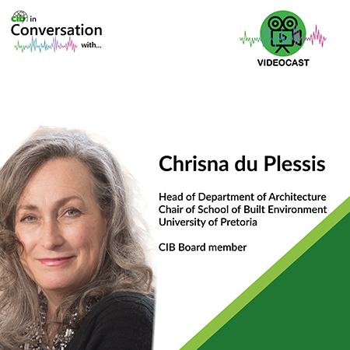
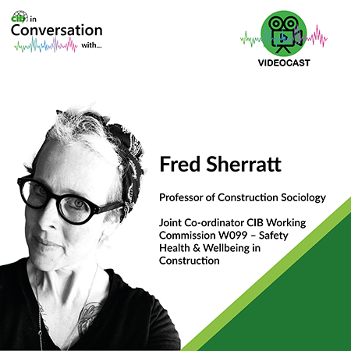
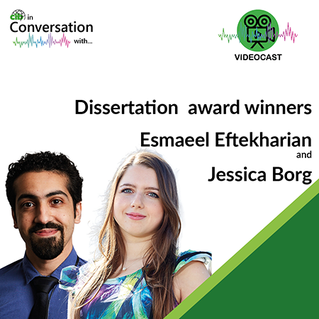
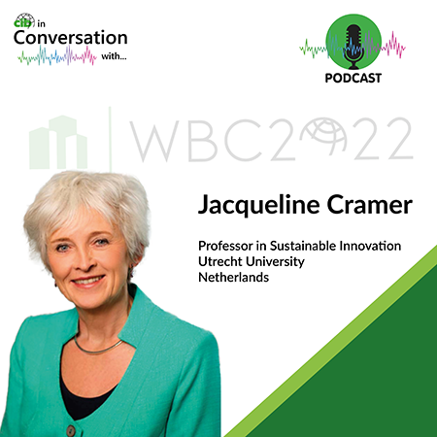
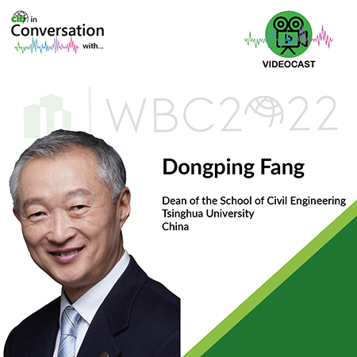
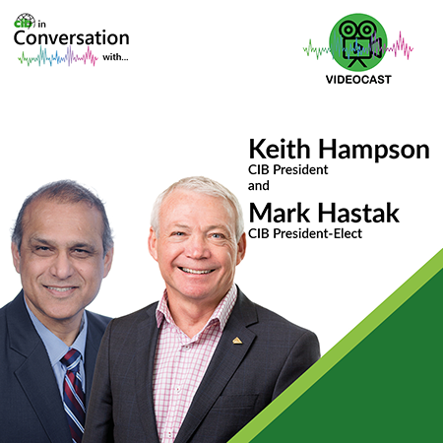

CIB on YouTube
CIB President’s Seminar series
– distinguished women researchers
CIB in Conversation
Lots of webinars and other content
@CIBSecretariat
Notes:
A large number of webinars and lectures are hosted by CIB and its Commissions. The YouTube channel provides an excellent library of these.

Slide 21
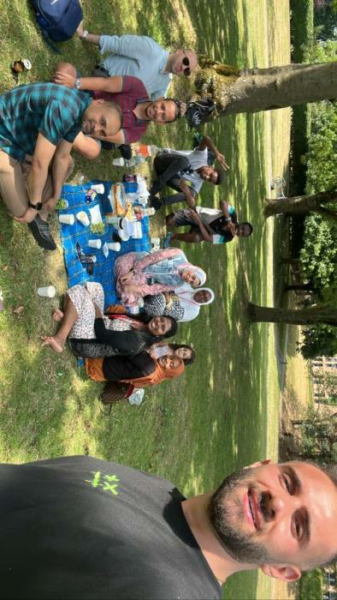
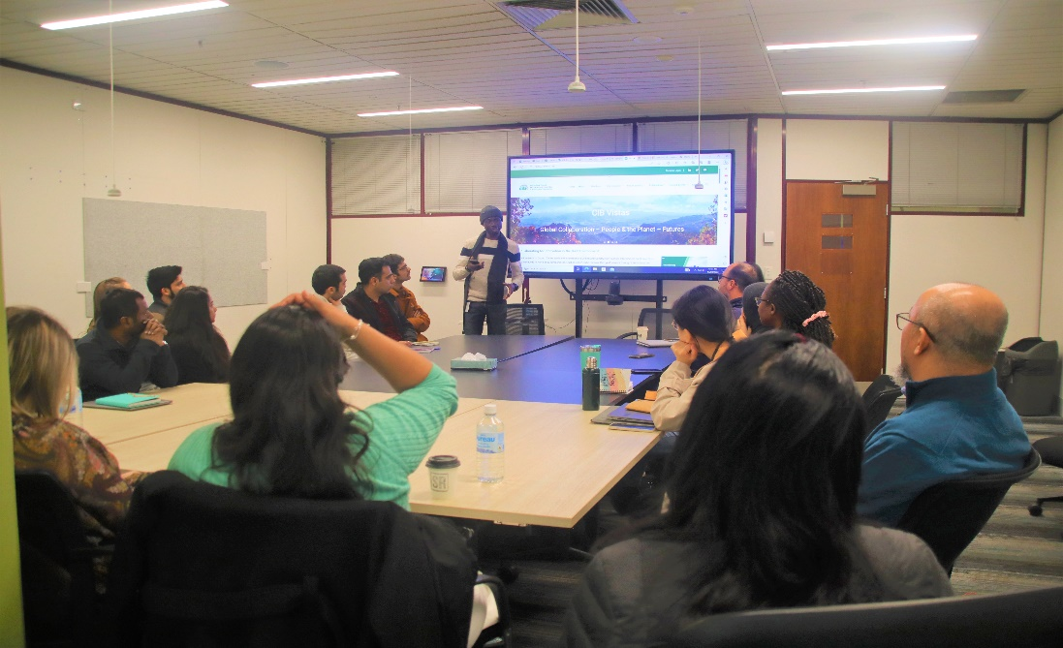
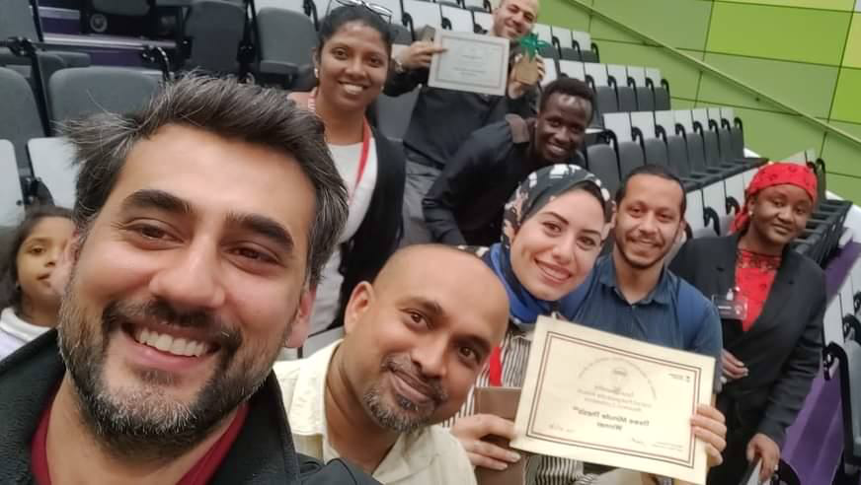
Student Chapters
First founded in 1998, now 20
Regular events including research seminars, professional development, networking
Awards and funding
  Sebestyén Future Leaders Award
  Best Doctoral Thesis Award
  Vistas funding
Notes:
Student Chapters are usually associated with universities and provide a means for students at Doctoral or Masters level to network with their peers including internationally .
- as per slide
More information on the activities of each Chapter can be easily found on the website

Slide 22
Student Chapters
Curtin University (Australia)
Hong Kong University
Hong Kong Polytechnic University
London South Bank University (UK)
Massey University (NZ)
Middle East Technical University (Turkey)
Nelson Mandela University (South Africa)
Newcastle University (Australia)
Politecnico Milana (Italy)
Pretoria University (South Africa)
Purdue University (USA)
RMIT University (Australia)
Tsinghua University (China)
University of Huddersfield (UK)
University of Salford (UK)
Virginia Tech (USA)
Western Sydney University (Australia)
Association of Schools of South Africa
CIB Working Commission W080
Hungarian Universities
Notes:
Student Chapters are usually associated with universities and provide a means for students at Doctoral or Masters level to network with their peers including internationally .
- as per slide
More information on the activities of each Chapter can be easily found on the website

Slide 23

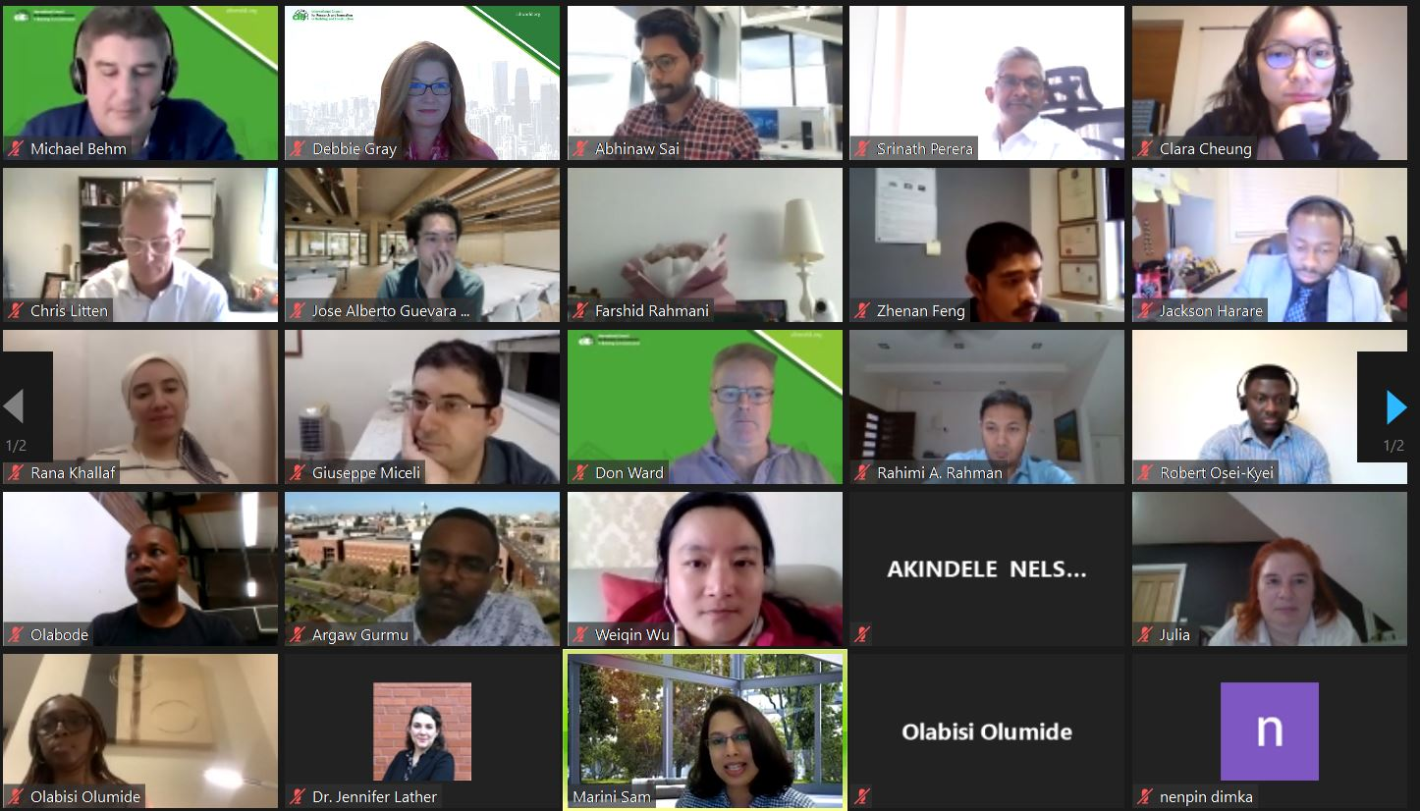
Early Career Researchers (ECR) network
Global online network since 2021 supporting early career development, free to join
Engage with discipline-specific
Commissions or Task Groups
Personal development webinars
Awards:
  Hampson Award for ECR-Industry collaboration
  Visiting Global Scholar Programme
Notes:
We think about ECRs as those who are 5 years or less into their career, whether in academia or industry or policy
To enhance their career development, we set up the ECR network in 2021….
- see slide

Slide 24
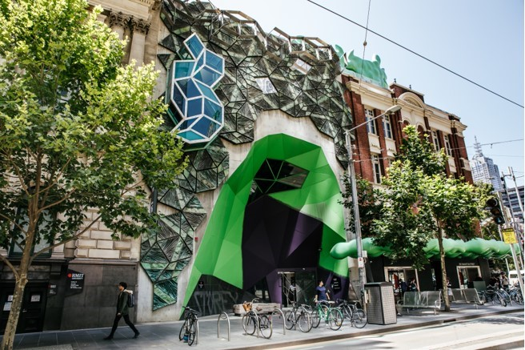
World Building Congress since 1959
2025 Purdue, USA
2022 Melbourne, Australia
2019 Hong Kong, China
2016 Tampere, Finland
2013 Brisbane, Australia
2010 Salford, UK
2007 Cape Town, South Africa
2004 Toronto, Canada
2001 Wellington, New Zealand
1998 Gävle, Sweden
1995 Amsterdam, Netherlands
1992 Montreal, Canada
1989 Paris, France
1986 Washington DC, USA
1983 Stockholm, Sweden
1980 Oslo, Norway
1977 Edinburgh, UK
1974 Budapest, Hungary
1971 Paris/Versailles, France
1968 Ottawa/Washington DC, Canada/USA
1965 Copenhagen, Denmark
1962 Cambridge, UK
1959 Rotterdam, Netherlands
Notes:
Every 3 years CIB holds the World Building Congress.
Most of the Working Commissions will hold sessions at the Congress, and it is THE place to be if you are active in research in this sector or interested in innovation.
The most recent event was hosted by RMIT in Melbourne in June 2022, and the Proceedings and session recordings are available from the website.

Slide 25
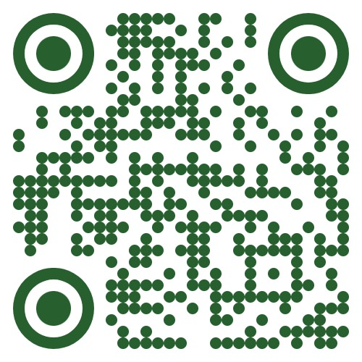

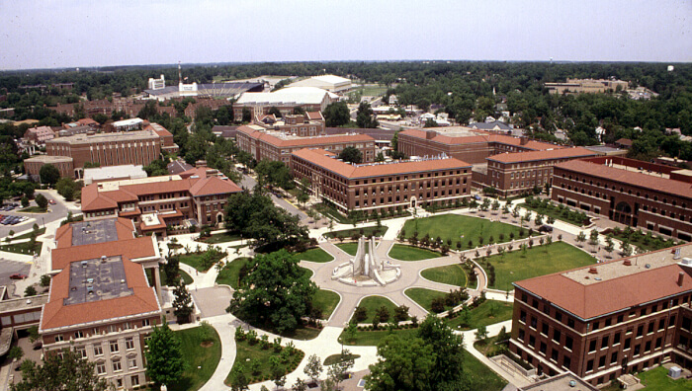
World Building Congress 2025
Purdue University, USA
CIB’s WBC is held every 3 years
650 people from 39 countries attended WBC2022 in Melbourne
The 23rd will be in West Lafayette, USA,
19-22 May 2025
  Call for Abstracts closed in March*
  Call for industry case studies in August
  Full papers by November 17th 2024
  www.wbc2025.cibworld.org
Notes:
The next WBC will be hosted by Purdue University in the USA from 19-22 May 2025.
Lots more information on the WBC2025 website, and we look forward to seeing you there!

Slide 26
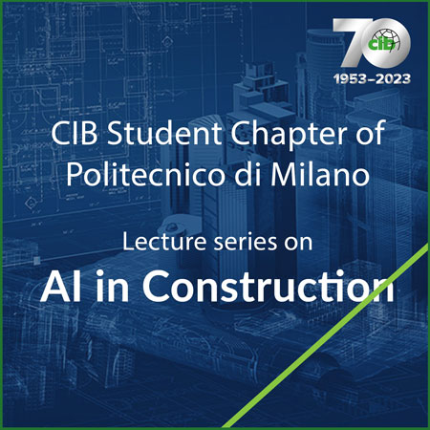
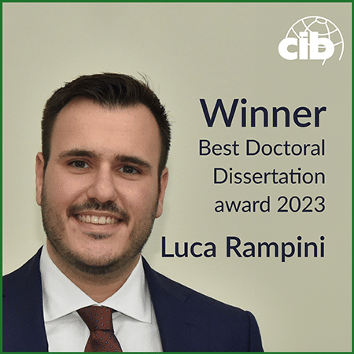
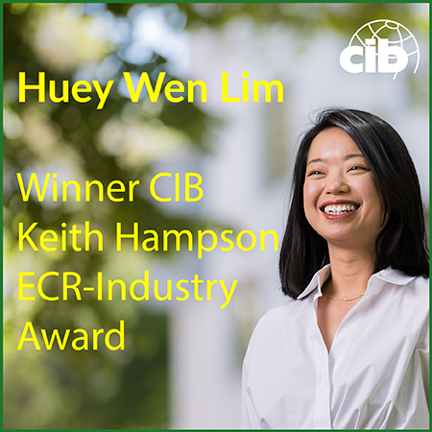
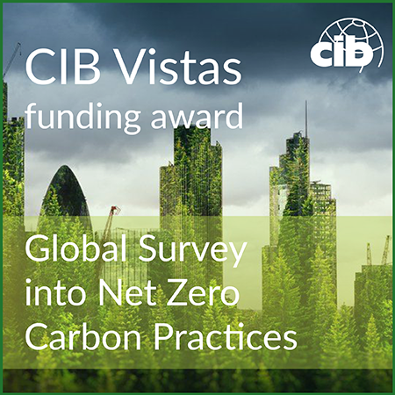

Awards and funding
Sebestyén Future Leaders Award
  €2,500 prize for a CIB Student Chapter to carry out research
  Call for entries in January, deadline end March
Best Doctoral Research Award
  €1,500 prize for the best PhD thesis in the previous 18 months,
  €500 for 2 runners-up
  Call for entries in May, deadline end September
Keith Hampson ECR-Industry Award
  €1,000 prize to promote new and innovative connections between ECRs and the built environment industry
  Call for entries in June, deadline end October
CIB Vistas programme
  Funding competition for €10,000, deadline end December
  Call for entries in September, deadline end December
cibworld.org/student-awards
cibworld.org/vistas-programme
Notes:
READ TITLES
Vistas is a funding programme not an award as such
The dates when the competition is open are shown here, as are the 3 winners in 2023 on the RHS, congratulations to them all
See https://cibworld.org/student-awards/

Slide 27

Sebestyén Future Leaders Award
Exposing future leaders of the building sector to the latest developments in building research
Award of €2,500 for a CIB Student Chapter to carry out research
2024 winner: Politecnico di Milano
  “Digital Tools for Circular Economy in the Construction Sector”
Next call for entries January 2025
See cibworld.org/student-awards
Notes:
Just a slide now on each of our three main awards aimed at students or ECRs
The first is ….
- see slide

Slide 28
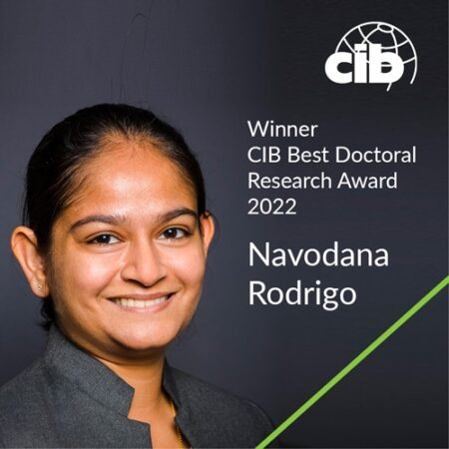

Best Doctoral Thesis Dissertation Award
Annual €1,500 prize for the best global PhD thesis in the previous 18 months, €500 for 2 runners-up
2023 winner:
Dr. Luca Rampini, Politecnico di Milano
  “Artificial intelligence enhances digital asset management”
Next call for entries May 2024,
deadline end September
See cibworld.org/student-awards
Notes:
The Dissertation award was launched in 2021 and look out for the next call for entries in the middle of each year

Slide 29

Hampson ECR-Industry Award
Annual prize of €1,000 to promote new and innovative connections between ECRs and the built environment industry
2024 winner:
Huey Wen Lim, University of Melbourne
  “Building Wellbeing in Construction 4.0: Unveiling the Influence of Prefabrication Construction Practices on Mental Health”
Next call for entries June 2024,
deadline end September
See cibworld.org/student-awards
Notes:
Our newest award is thanks to the Immediate Past President Keith Hampson who has spent a career working at the nexus of industry and academia
- see slide
More information on all these awards is of course on our website under awards

Slide 30

Sector improvement – global trends
Safety, health and well-being
Digital – BIM, drones, robotics, 3D printing etc etc
Modern methods of construction, offsite, industrialised construction
“Intelligent client”
Environmental sustainability, embodied carbon, net zero, resilience
Social value, local employment
Transparency, traceability
Productivity, lean
Huge interest and uncertainty re AI
Notes:
Around the globe here are some of the trends affecting our sector, and where research is critically informing policy and practice.

Slide 31

Thank you
Don Ward, Chief Executive
don.ward@cibworld.org
www.linkedin.com/in/don-ward-8203269/
www.cibworld.org
Notes:
So I hope this overview has been helpful.
Much more information about all aspects of our work is available on the website, including a copy of this slide deck if you wish to download a copy.
if you have any questions or wish to get involved, please contact secretariat@cibworld.org and someone will be in touch promptly.
Thank you for watching and listening

