Slide 1
70 years of cooperation to build a more sustainable world
2023 Platinum Anniversary
Notes:
June 2023 sees the 70th anniversary of establishing the CIB.

Slide 2
Our proud history
1950 - Origins of CIB, UNECE (CIDB)
1953 - CIB is formally established
1950^{s}/60^{s} - Post war growth
1959 - CIB 1st International Congress
1970^{s}/80^{s} - Oil crises, slump and resilience
1990^{s}/2000^{s} - Student Chapters, Sustainability
1998 - CIB changes name
2010^{s}/20^{s} - Increased scope, global pandemic
2019 - CIB moves office to Canada
2021 - ECR Network
2023 - SDGs
Notes:
1950 Origins of CIB: United Nations Economic Commission for Europe (ECE) establishes International Council for Building Documentation (CIDB) and ‘ECE Conference on Building Research’ in Geneva
1953 CIB is formally established as “Conseil International du Bâtiment” (in English: International Council of Building) with the longer title: INTERNATIONAL COUNCIL FOR BUILDING RESEARCH, STUDIES AND DOCUMENTATION, Inaugural Assembly: June 1953, in Geneva
1950/60s – 36 institutes initially come together, embarking on a post-war road of development, this grows to 43 institutes with 215 members amidst high demand for building, CIB has a strong focus on building technology and materials
1959 CIB 1st International Congress held in Rotterdam
1970/80s – began with the oil crisis, building slumps along with membership numbers, but building research enters a new era in the 80s, member numbers grow to 450
1990/2000s – research scope expands significantly to include wider construction issues, including sustainable development, a decline in national research funding, but growth of CIB Student Chapters, priority themes include ‘Sustainable Construction’
1998 CIB changes name, the CIB abbreviation remained but the full name changed into: INTERNATIONAL COUNCIL FOR RESEARCH AND INNOVATION IN BUILDING AND CONSTRUCTION
2010/20s – scope of research extends to topics such as: organisation and management, economics of building, legal and procurement practices, architecture, urban planning and human aspects, despite a global pandemic in 2020 CIB has shown resilience with 95 member organisations with around 3000 individual experts
2019 CIB moves, remains under jurisdiction of Netherlands law, with secretariat registered in Ottawa, Canada
2023 – begin alignment with UN SDGs, established Early Career Research Network

Slide 3
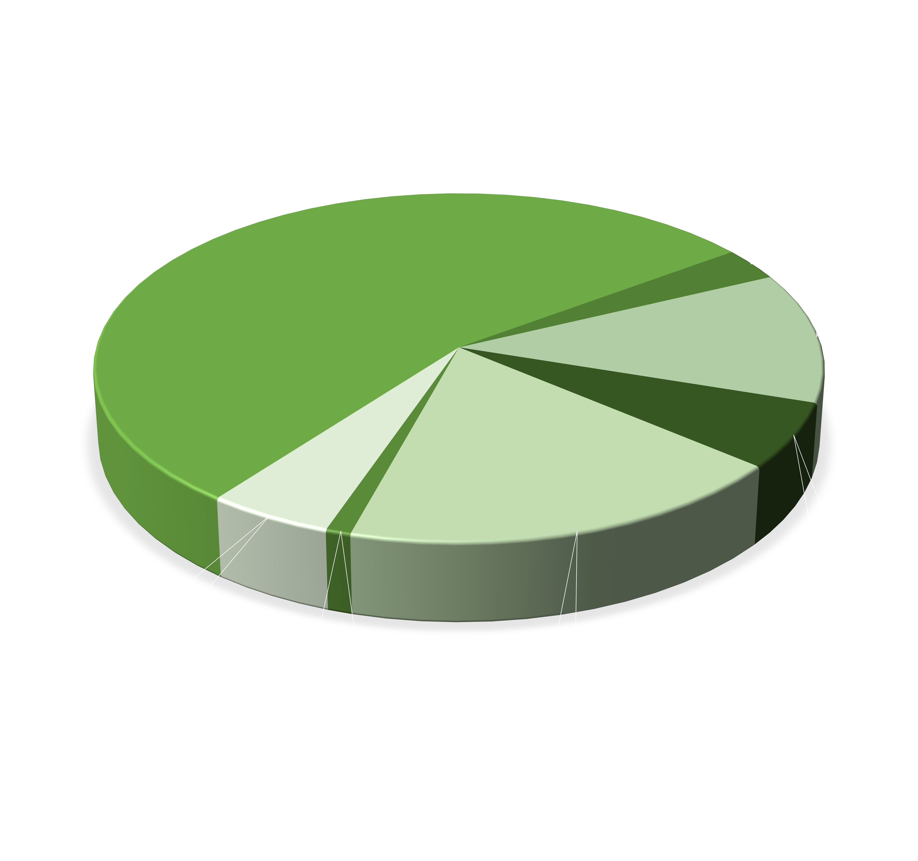
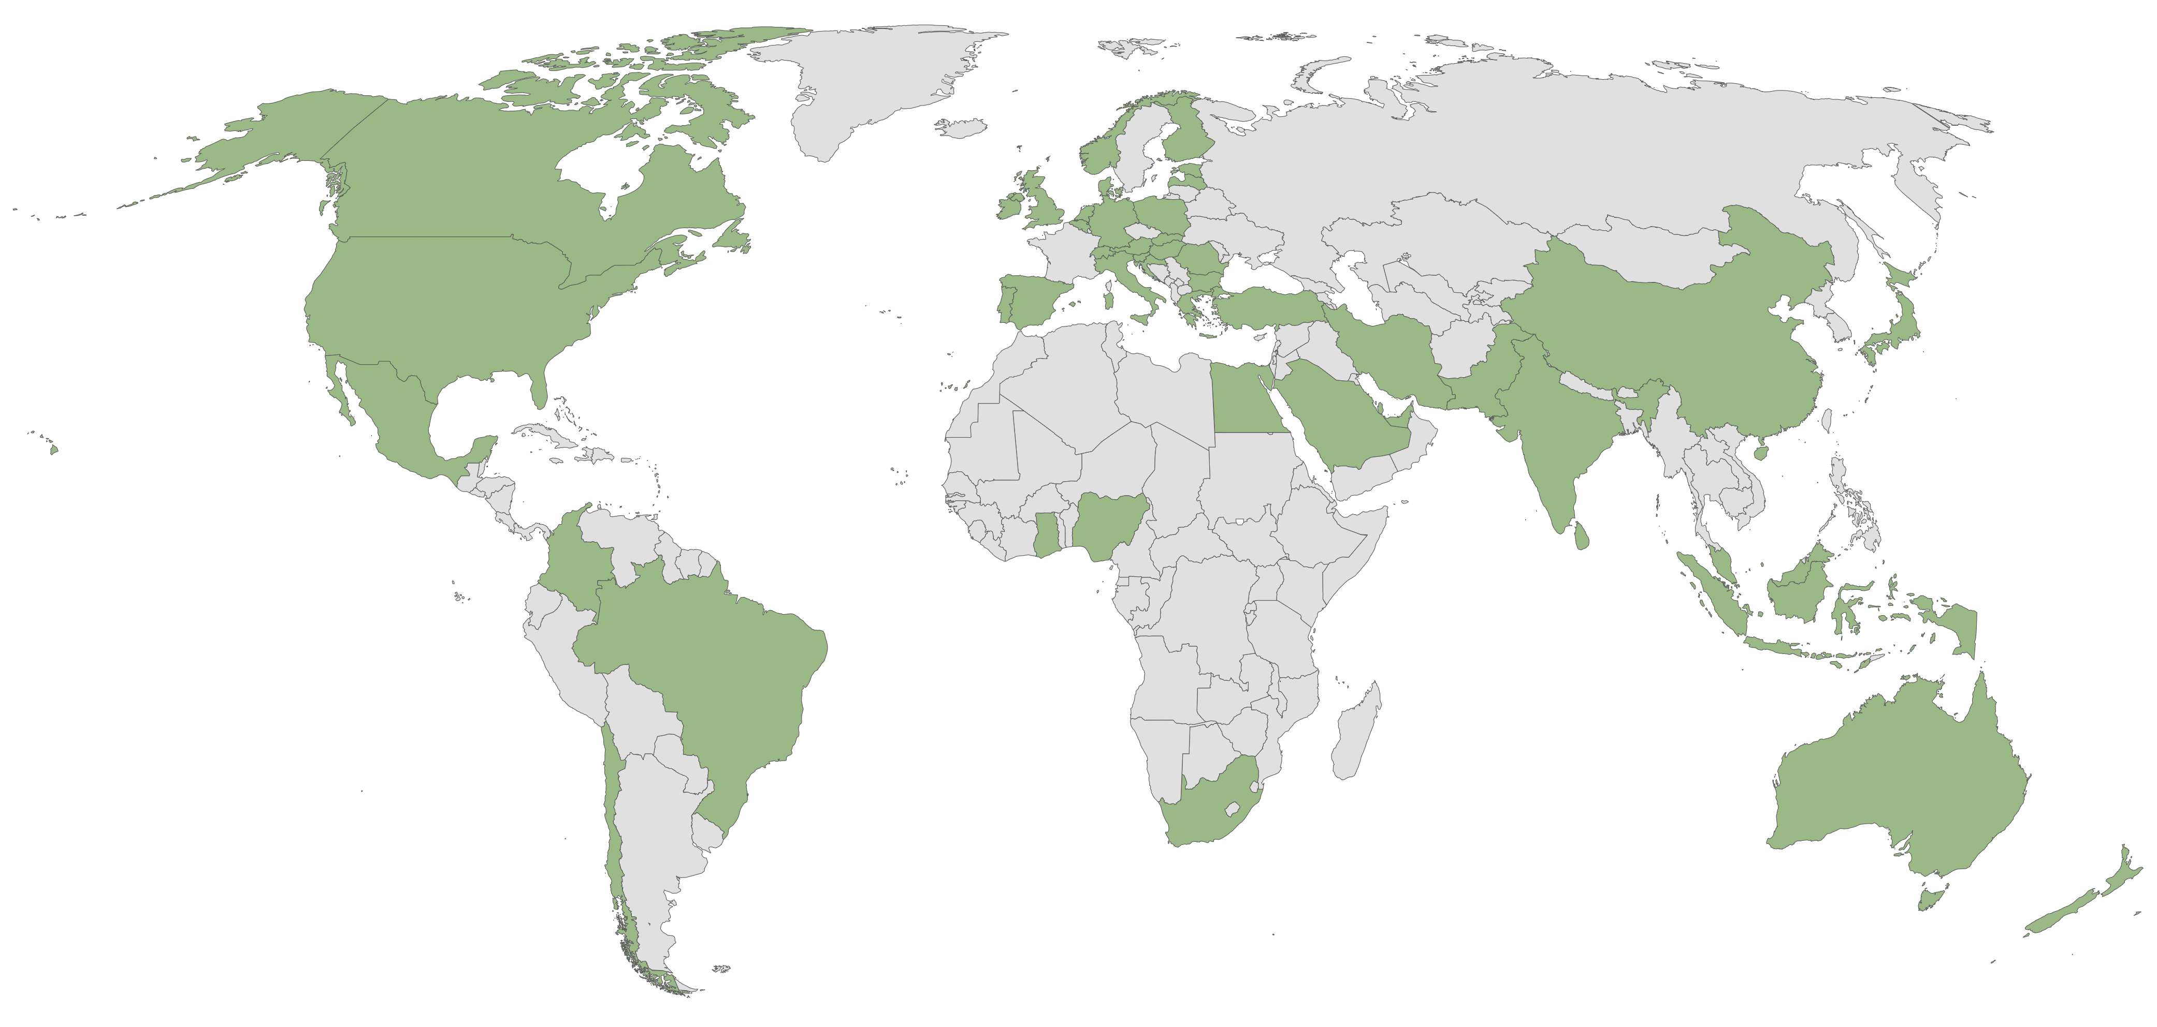
70 years of international cooperation
www.cibworld.org
Notes:
Focusing on achievements to date:
(1) CIB membership now includes 95 member organizations, with 3500 experts, covering 53 countries.
(2) The ICONDA®CIBlibrary database is the online repository for CIB and CIB related publications. It holds records and associated full text files of CIB related publications: monographic (conference proceedings, books, reports) as well as serial (journals).
(3) CIB Award winners to encourage engagement, innovation, and research excellence. Main photo shows all the winners on stage at the WBC Melbourne 2022. Navodana Rodrigo from Western Sydney University winner of the 2022 CIB Best Doctoral Research Award. Nazanin Kordestani (President of the Massey CIB Student Chapter) winner of the inaugural CIB Keith Hampson ECR-Industry Award.
(4) CIB is currently aligning all member activities and priority areas with the United Nations Sustainable Development Goals, demonstrating our commitment to building a saustainable future for all.

Slide 4
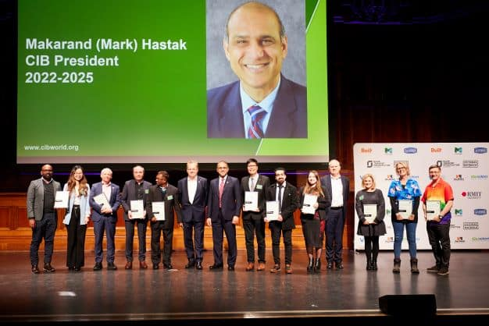
70 years of international cooperation
www.cibworld.org
Notes:
Focusing on achievements to date:
(1) CIB membership now includes 95 member organizations, with 3500 experts, covering 53 countries.
(2) The ICONDA®CIBlibrary database is the online repository for CIB and CIB related publications. It holds records and associated full text files of CIB related publications: monographic (conference proceedings, books, reports) as well as serial (journals).
(3) CIB Award winners to encourage engagement, innovation, and research excellence. Main photo shows all the winners on stage at the WBC Melbourne 2022. Navodana Rodrigo from Western Sydney University winner of the 2022 CIB Best Doctoral Research Award. Nazanin Kordestani (President of the Massey CIB Student Chapter) winner of the inaugural CIB Keith Hampson ECR-Industry Award.
(4) CIB is currently aligning all member activities and priority areas with the United Nations Sustainable Development Goals, demonstrating our commitment to building a saustainable future for all.

Slide 5
Beyond 70 years of international cooperation… [check title]
www.cibworld.org
Notes:
Focusing on future strategies and plans:
CIB is currently aligning all member activities and priority areas with the United Nations Sustainable Development Goals, demonstrating our commitment to building a sustainable future for all.

Slide 6
Anniversary activities
Commemorative review
Recorded webinar
Video tributes from Past Presidents, members and friends of CIB
Profile during major CIB events in 2023
CIB webpage with commentary and interviews
Notes:
(1) commemorative review to include history of CIB, reflections from past and present presidents, and other content on the work of CIB members
(2) recorded webinar will include short presentations from CIB Board members, past presidents and others
(3)Videos of reflections from past presidents and friends of CIB
(4) CIB conference events and regional champion events will mark the anniversary with a set of Power Point slides
(5) All content will be available on the CIB website

Slide 7
Local Activities
Notes:
Update or delete as required

